Slide 1
lidenz.com

Slide 2
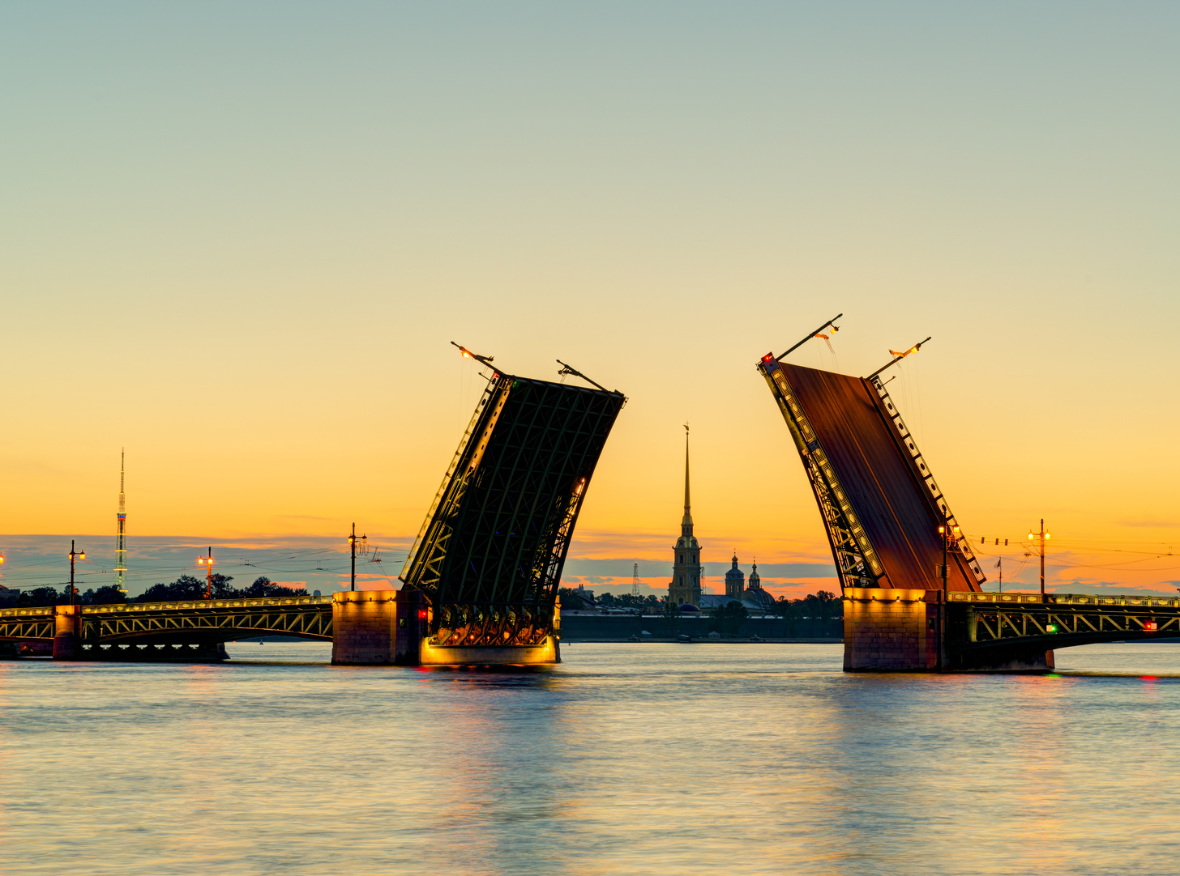
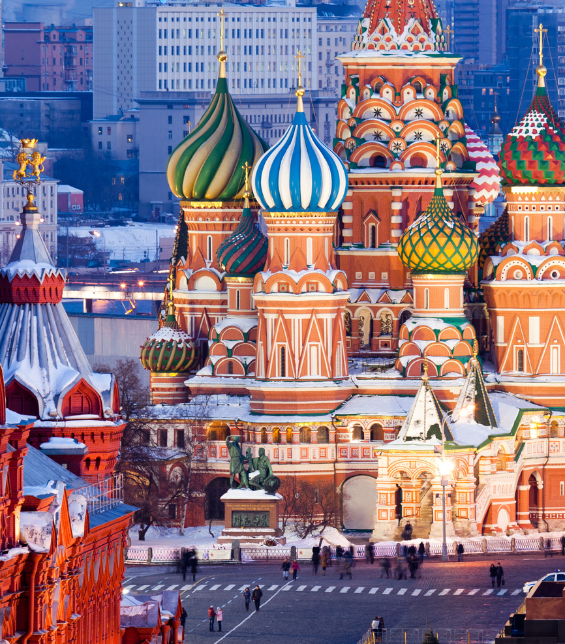
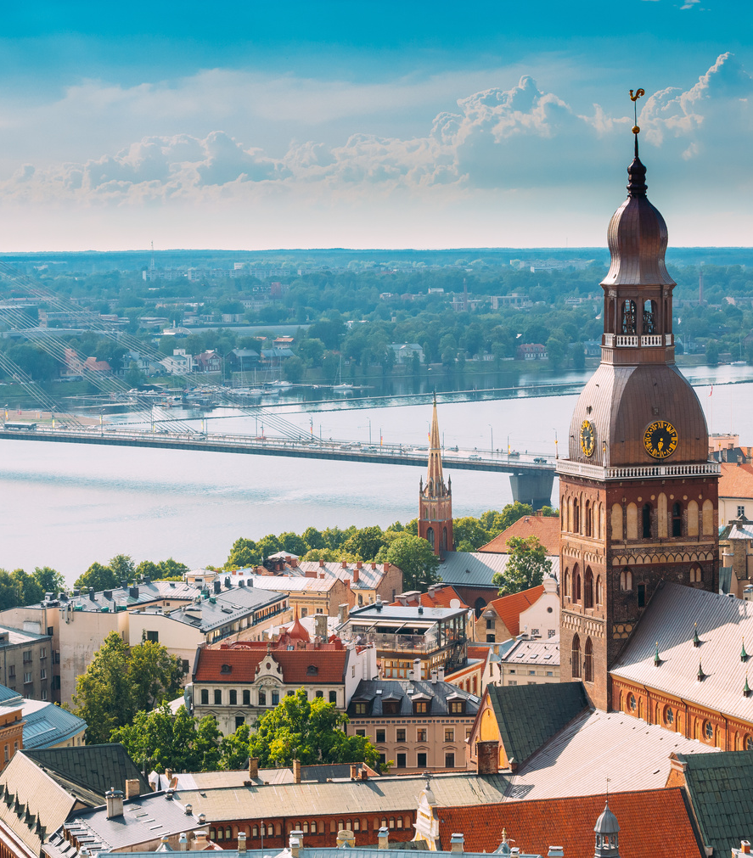
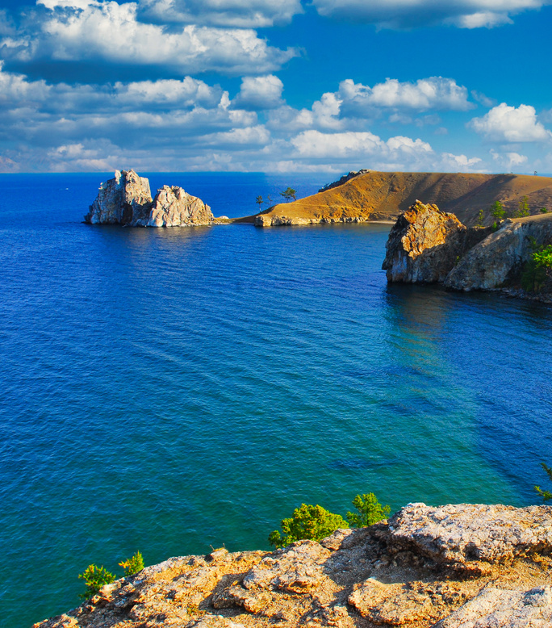
About Liden & Denz
Historic locations to explore
Excellent facilities
Maximum flexibility and choice
Quality control
Accredited and inspected
The professional choice
Examination Centres

Slide 3
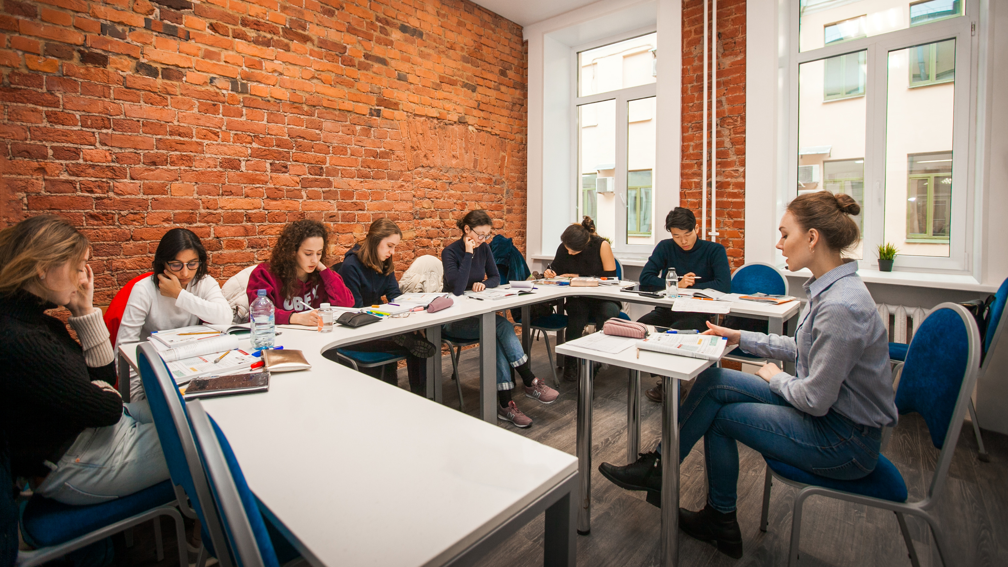
Year-round Group Courses: St.Petersburg, Moscow, Irkutsk, Riga
All destinations - levels offered: 8

Slide 4
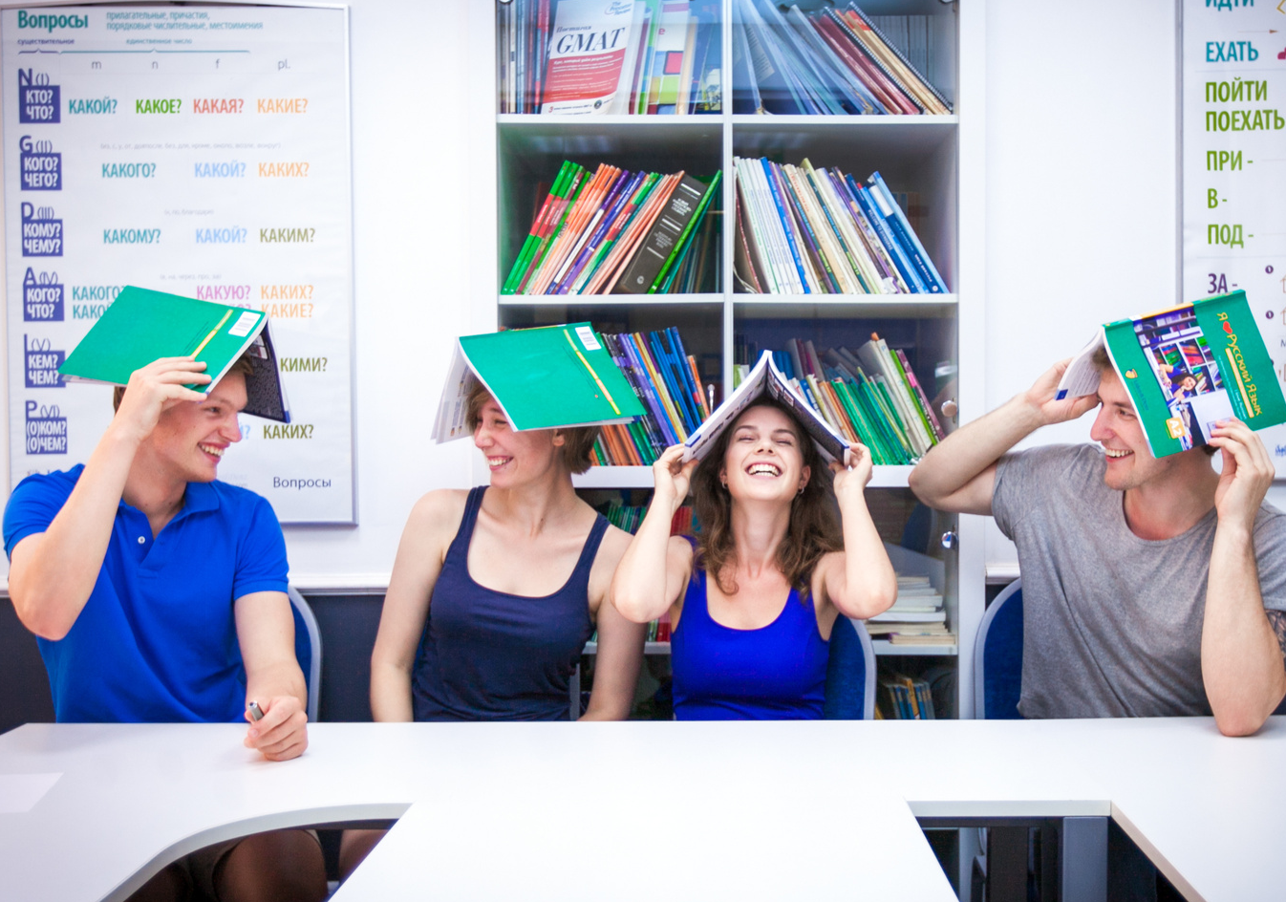
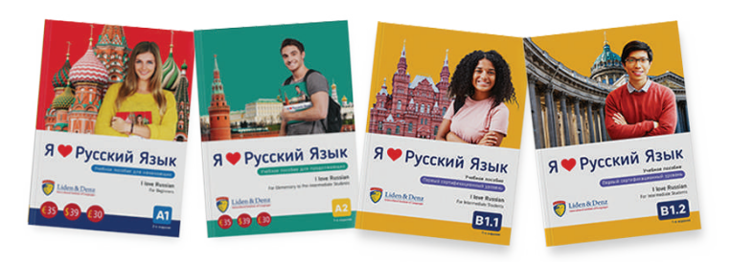
Teaching Materials
“I love Russian” is a new, illustrated textbook series created by Liden & Denz and aimed at international students studying Russian.
Communicative approach to language teaching
Dynamic and modern textbook
Audio files available via QR codes
Available for A1, A2, B1 and B1+ levels
We also offer teacher’s books and self-study materials

Slide 5
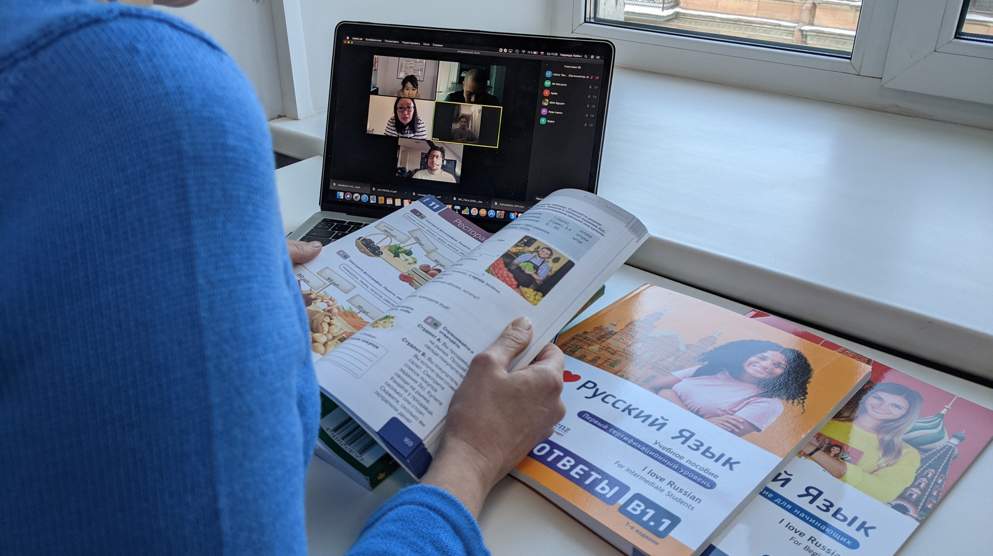
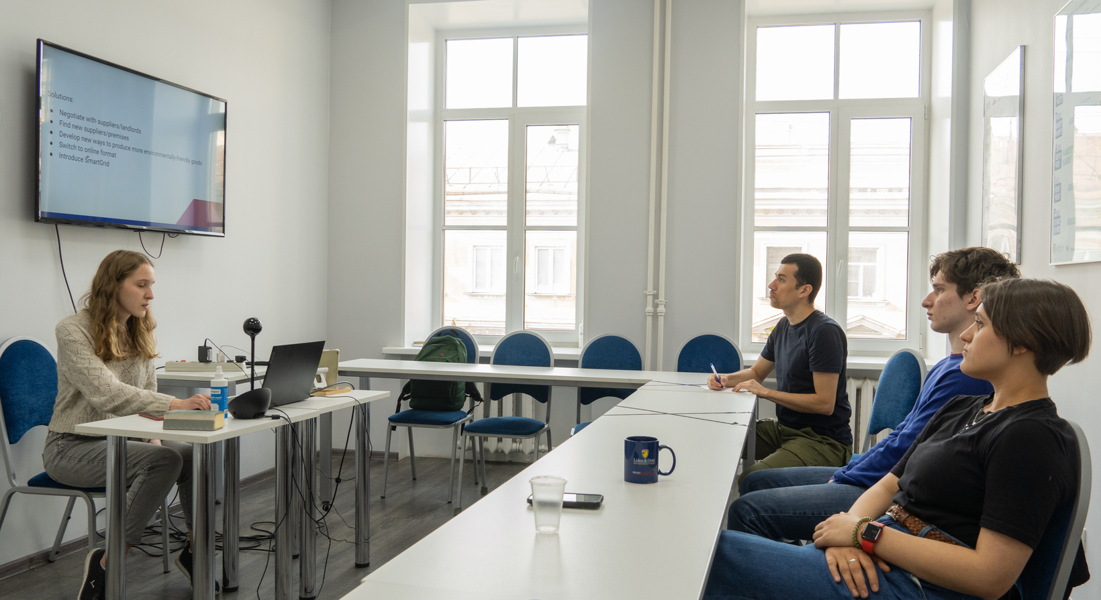
Multi-media technologies

Slide 6
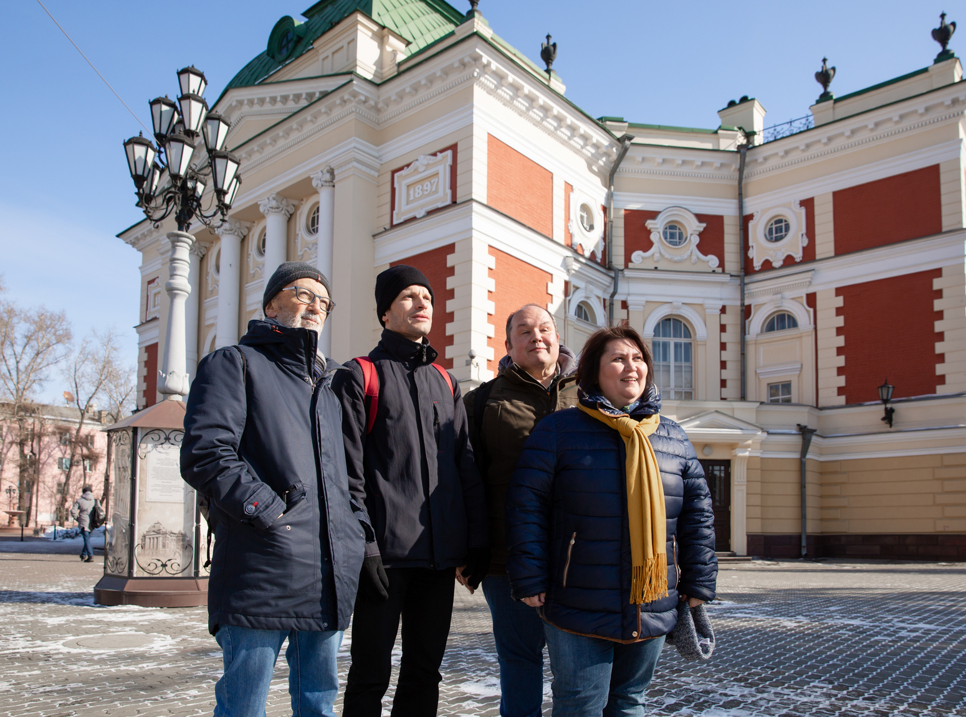
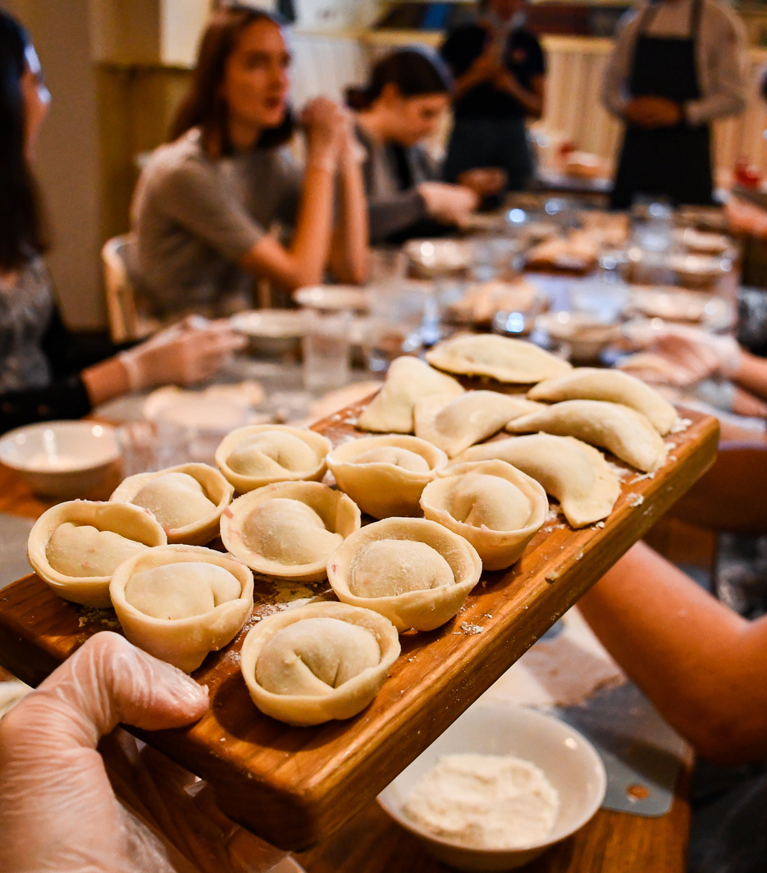
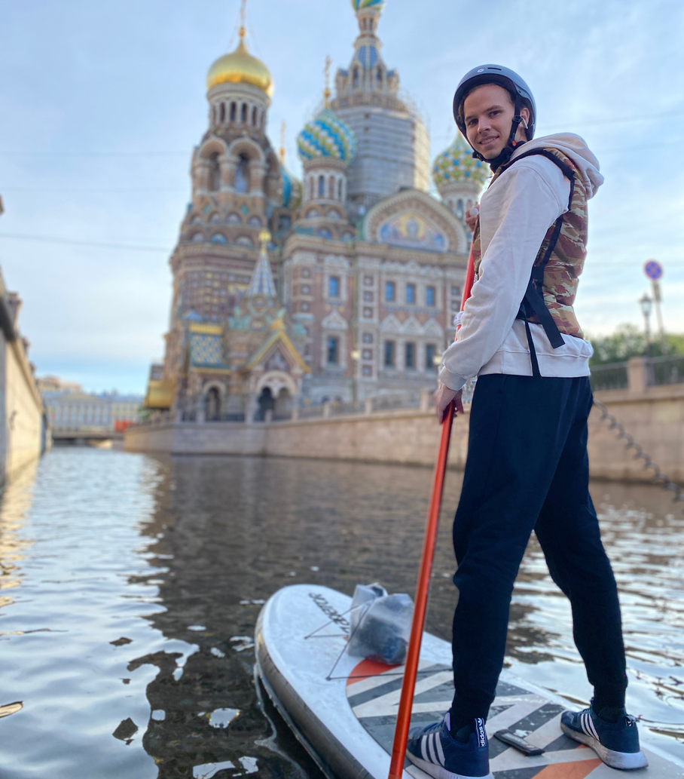
Outdoor teaching
Communicative approach: students use their language skills outside the classroom from the very beginning.
We regularly take them to the streets, markets, railway stations to practice what they have just learned.
Students are exposed to different speech patterns, dialects and age groups in various places with substantial levels of noise.
Students gain confidence of speaking in non-familiar situations.
Bonus: discovering the city under a different angle!

Slide 7
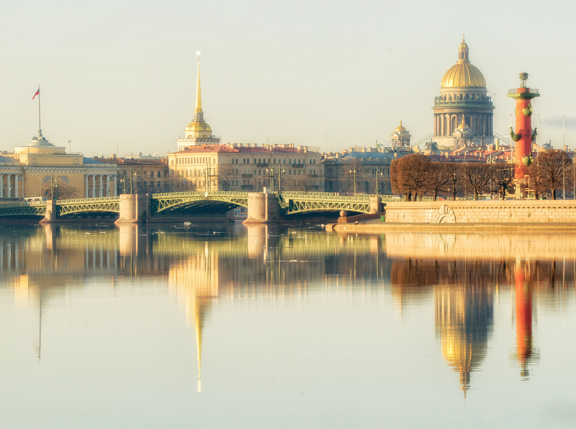
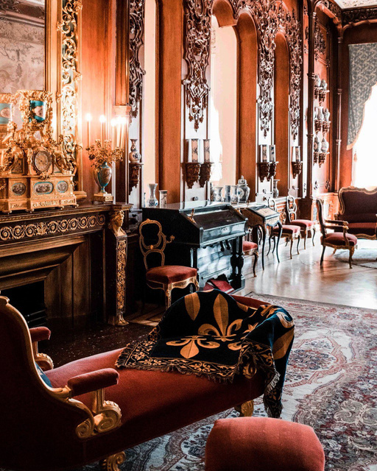
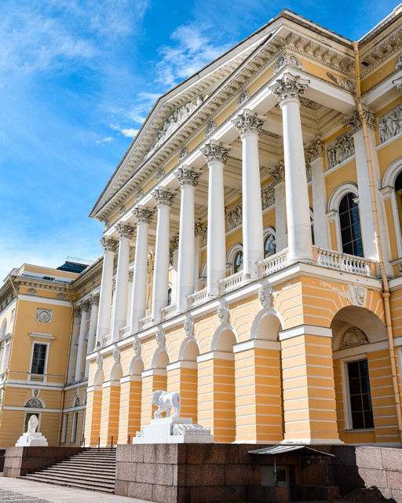
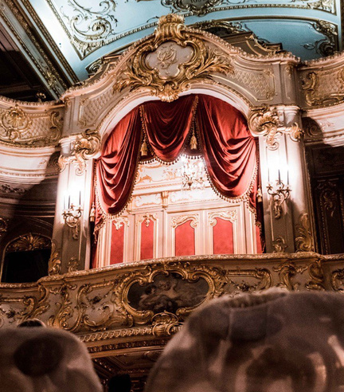
St. Petersburg
Founded in 1703 by Tsar Peter the Great on the delta of the river Neva
UNESCO World Cultural Heritage
Country’s cultural capital
Population today: 5 Million

Slide 8
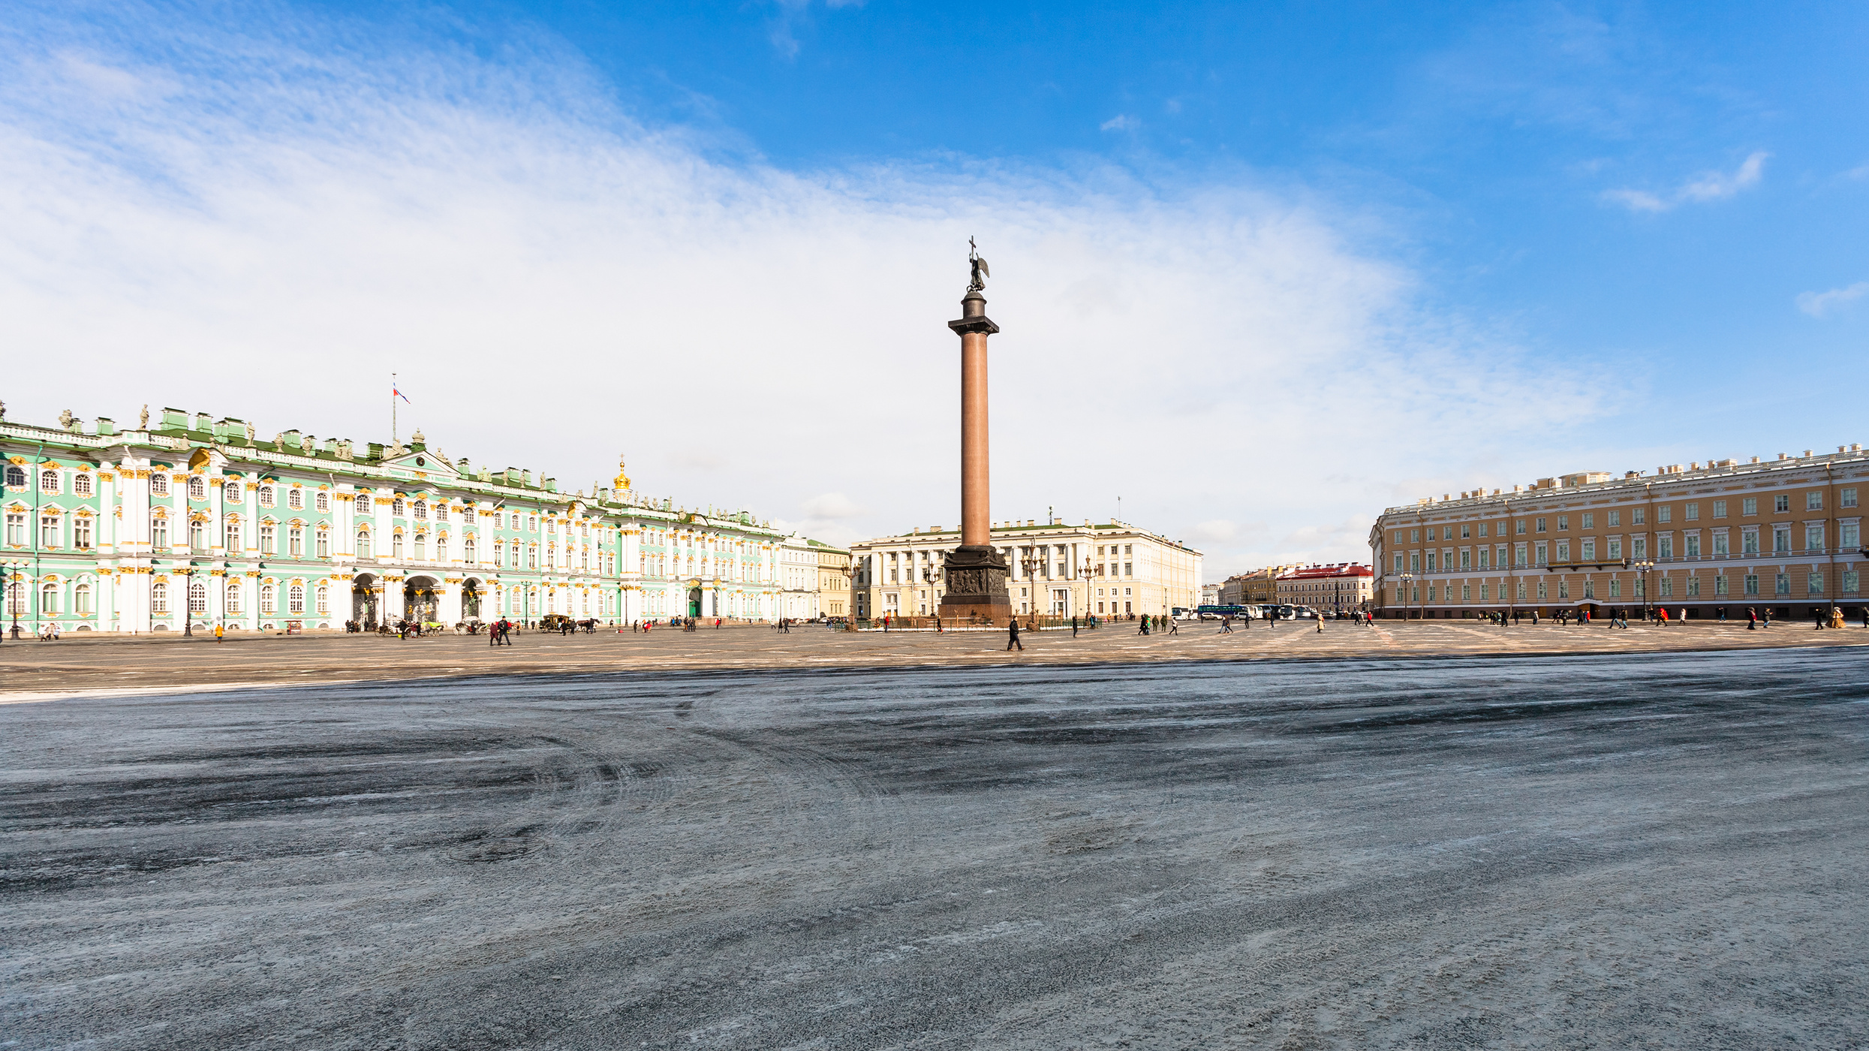

Slide 9
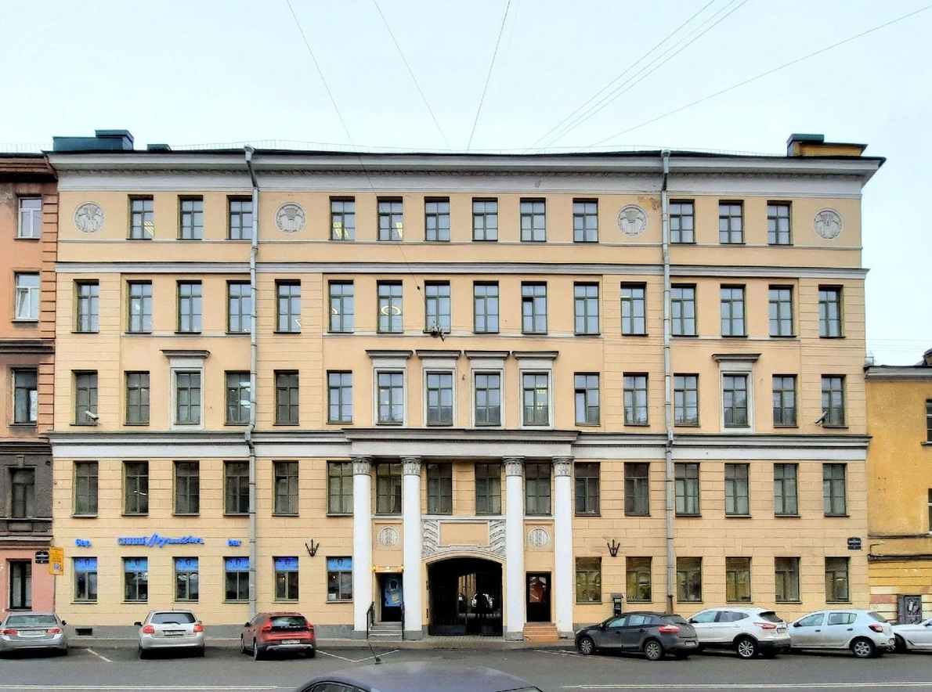
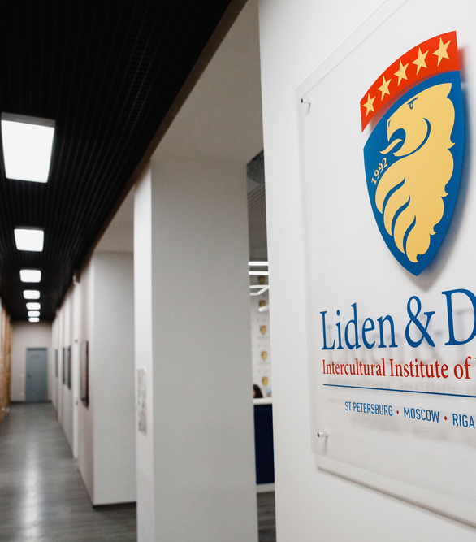
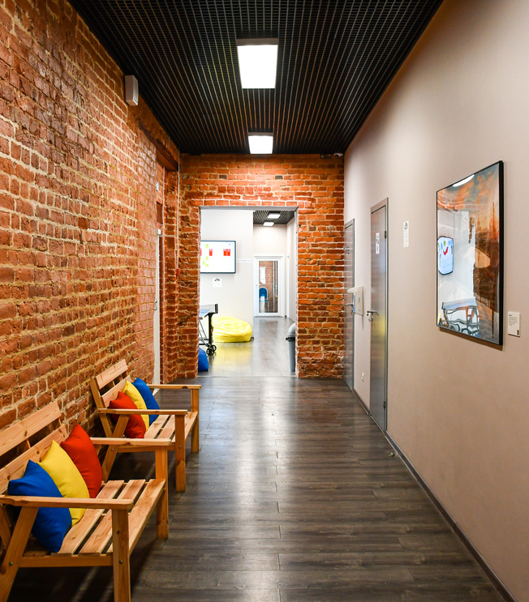
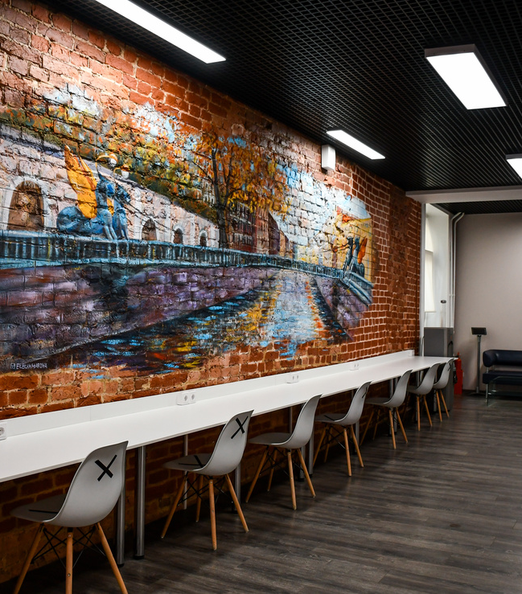
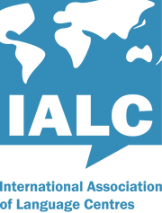
Liden & Denz
St. Petersburg
10 minute walk from Ploshad Vosstania/ Mayakovskaya Metro Station
17 spacious bright classrooms
Wall-mounted LCD screens in all classrooms
Free WiFi
Students’ lounge and self-study area
Coffee-shop

Slide 10
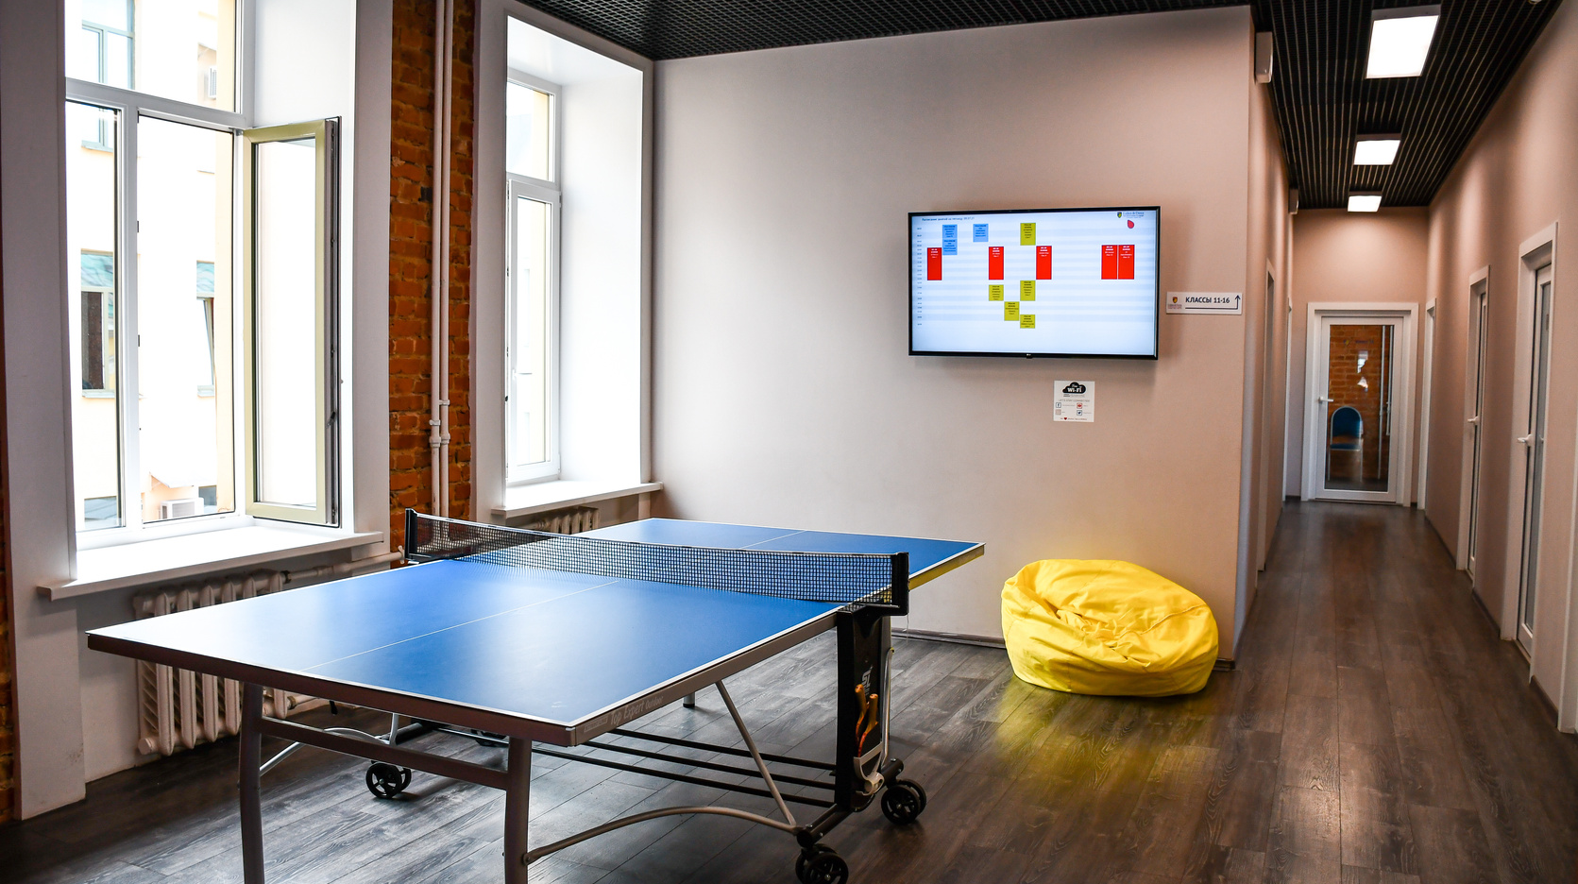
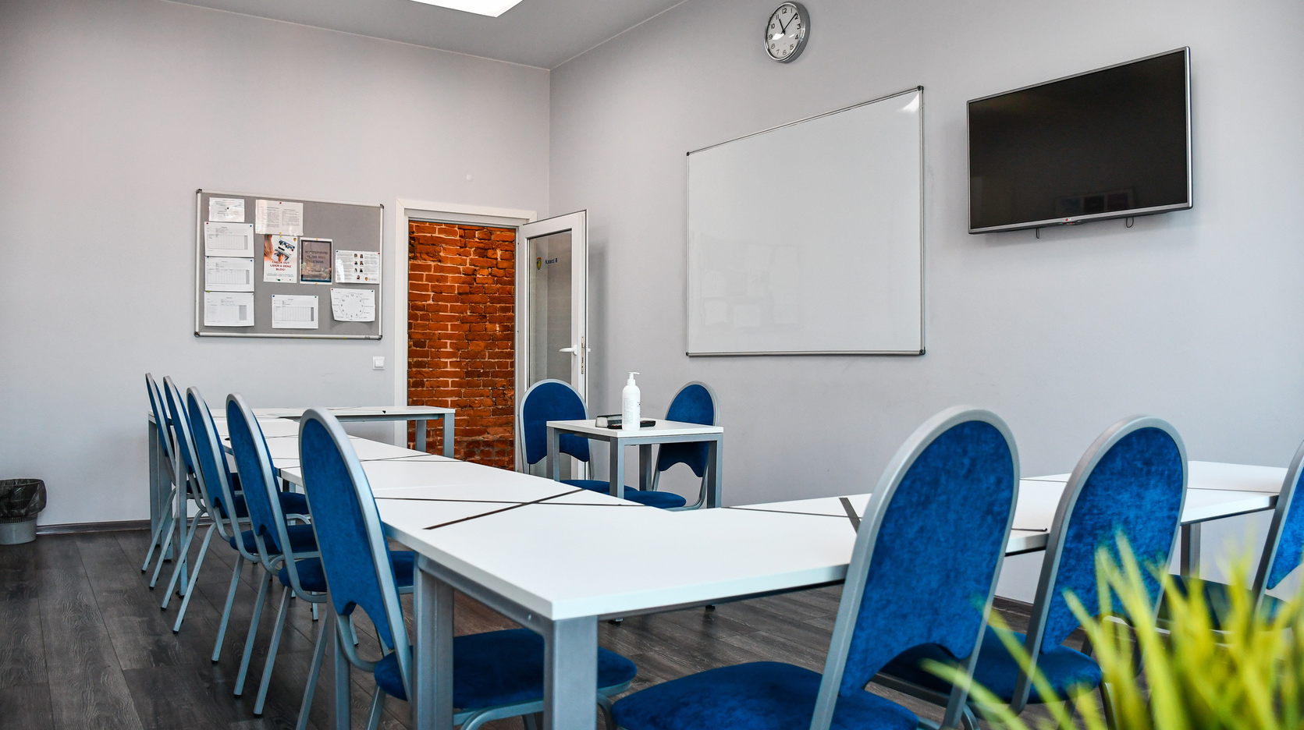
Group Courses: Maximum group size - 12

Slide 11
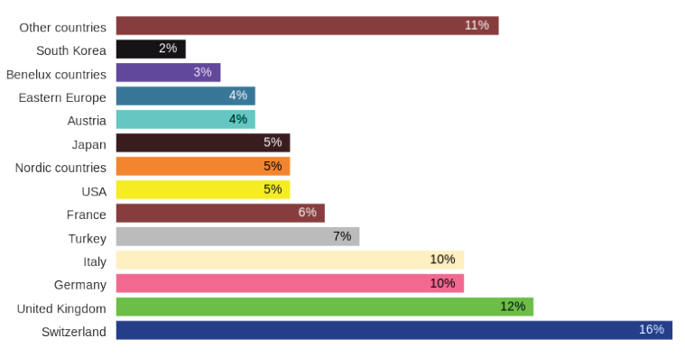
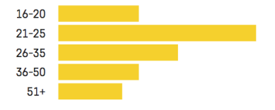
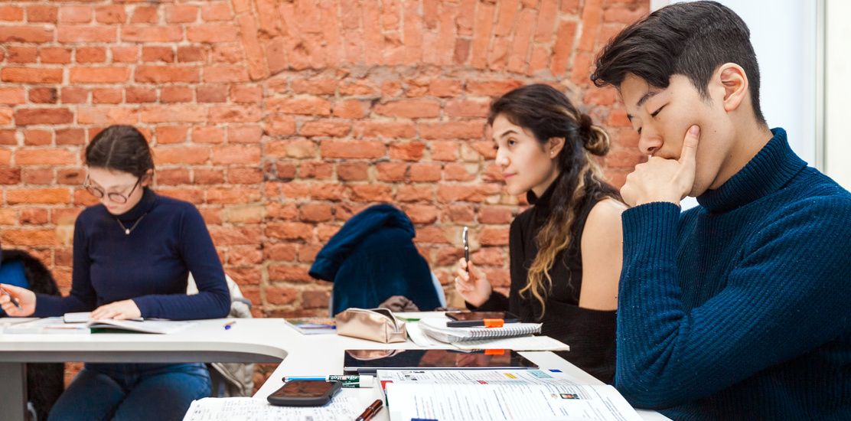
Liden & Denz St. Petersburg
Student Mix by country or region
Student Mix by age

Slide 13
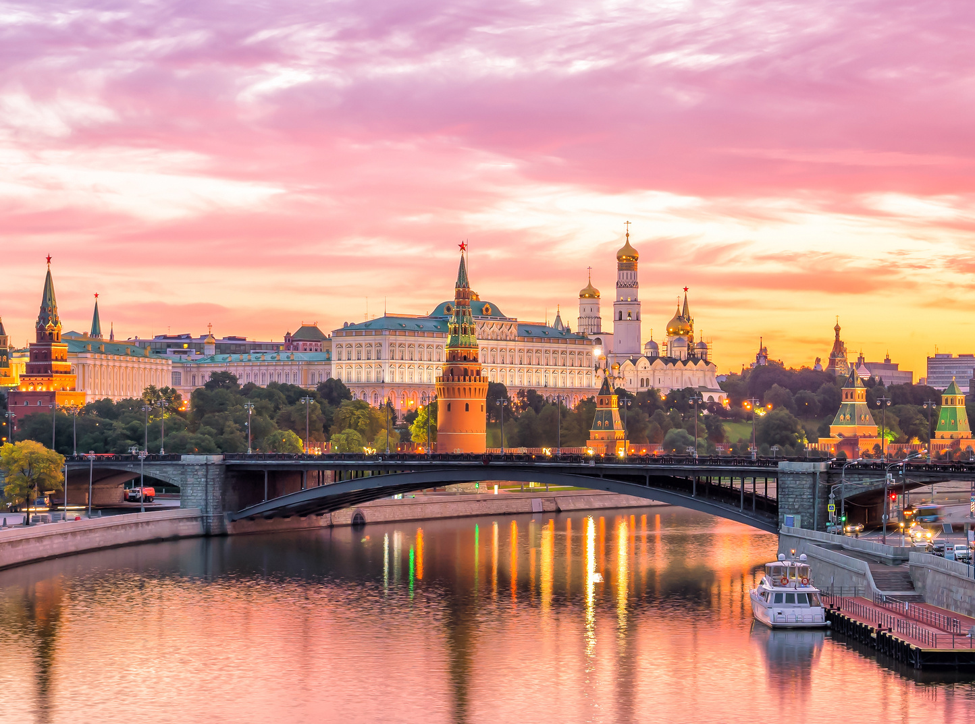
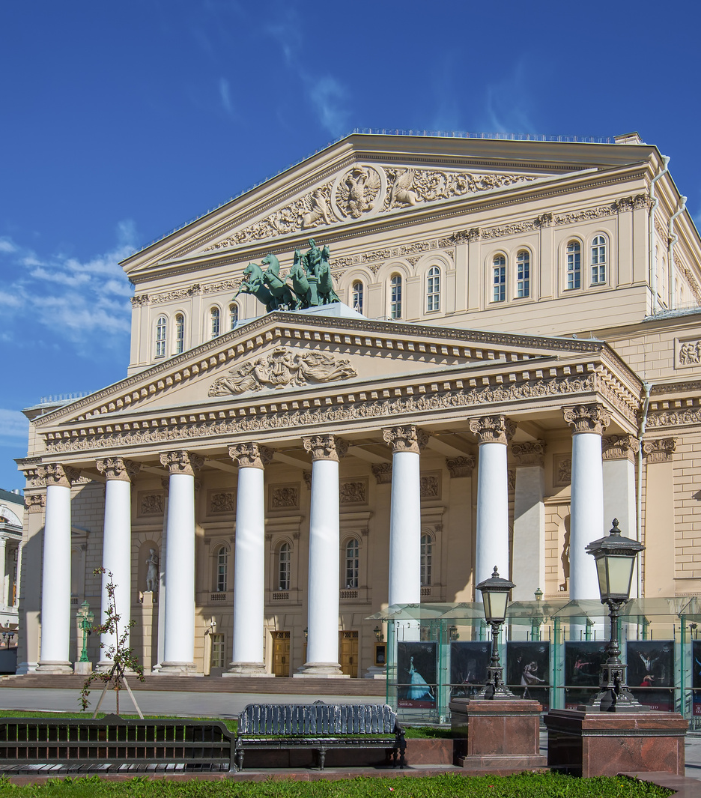
Moscow
Founded in 1147 by Yuri Dolgoruki
Recommenced as a capital after the October Revolution
Largest city in Europe with estimated population of 14 million

Slide 14
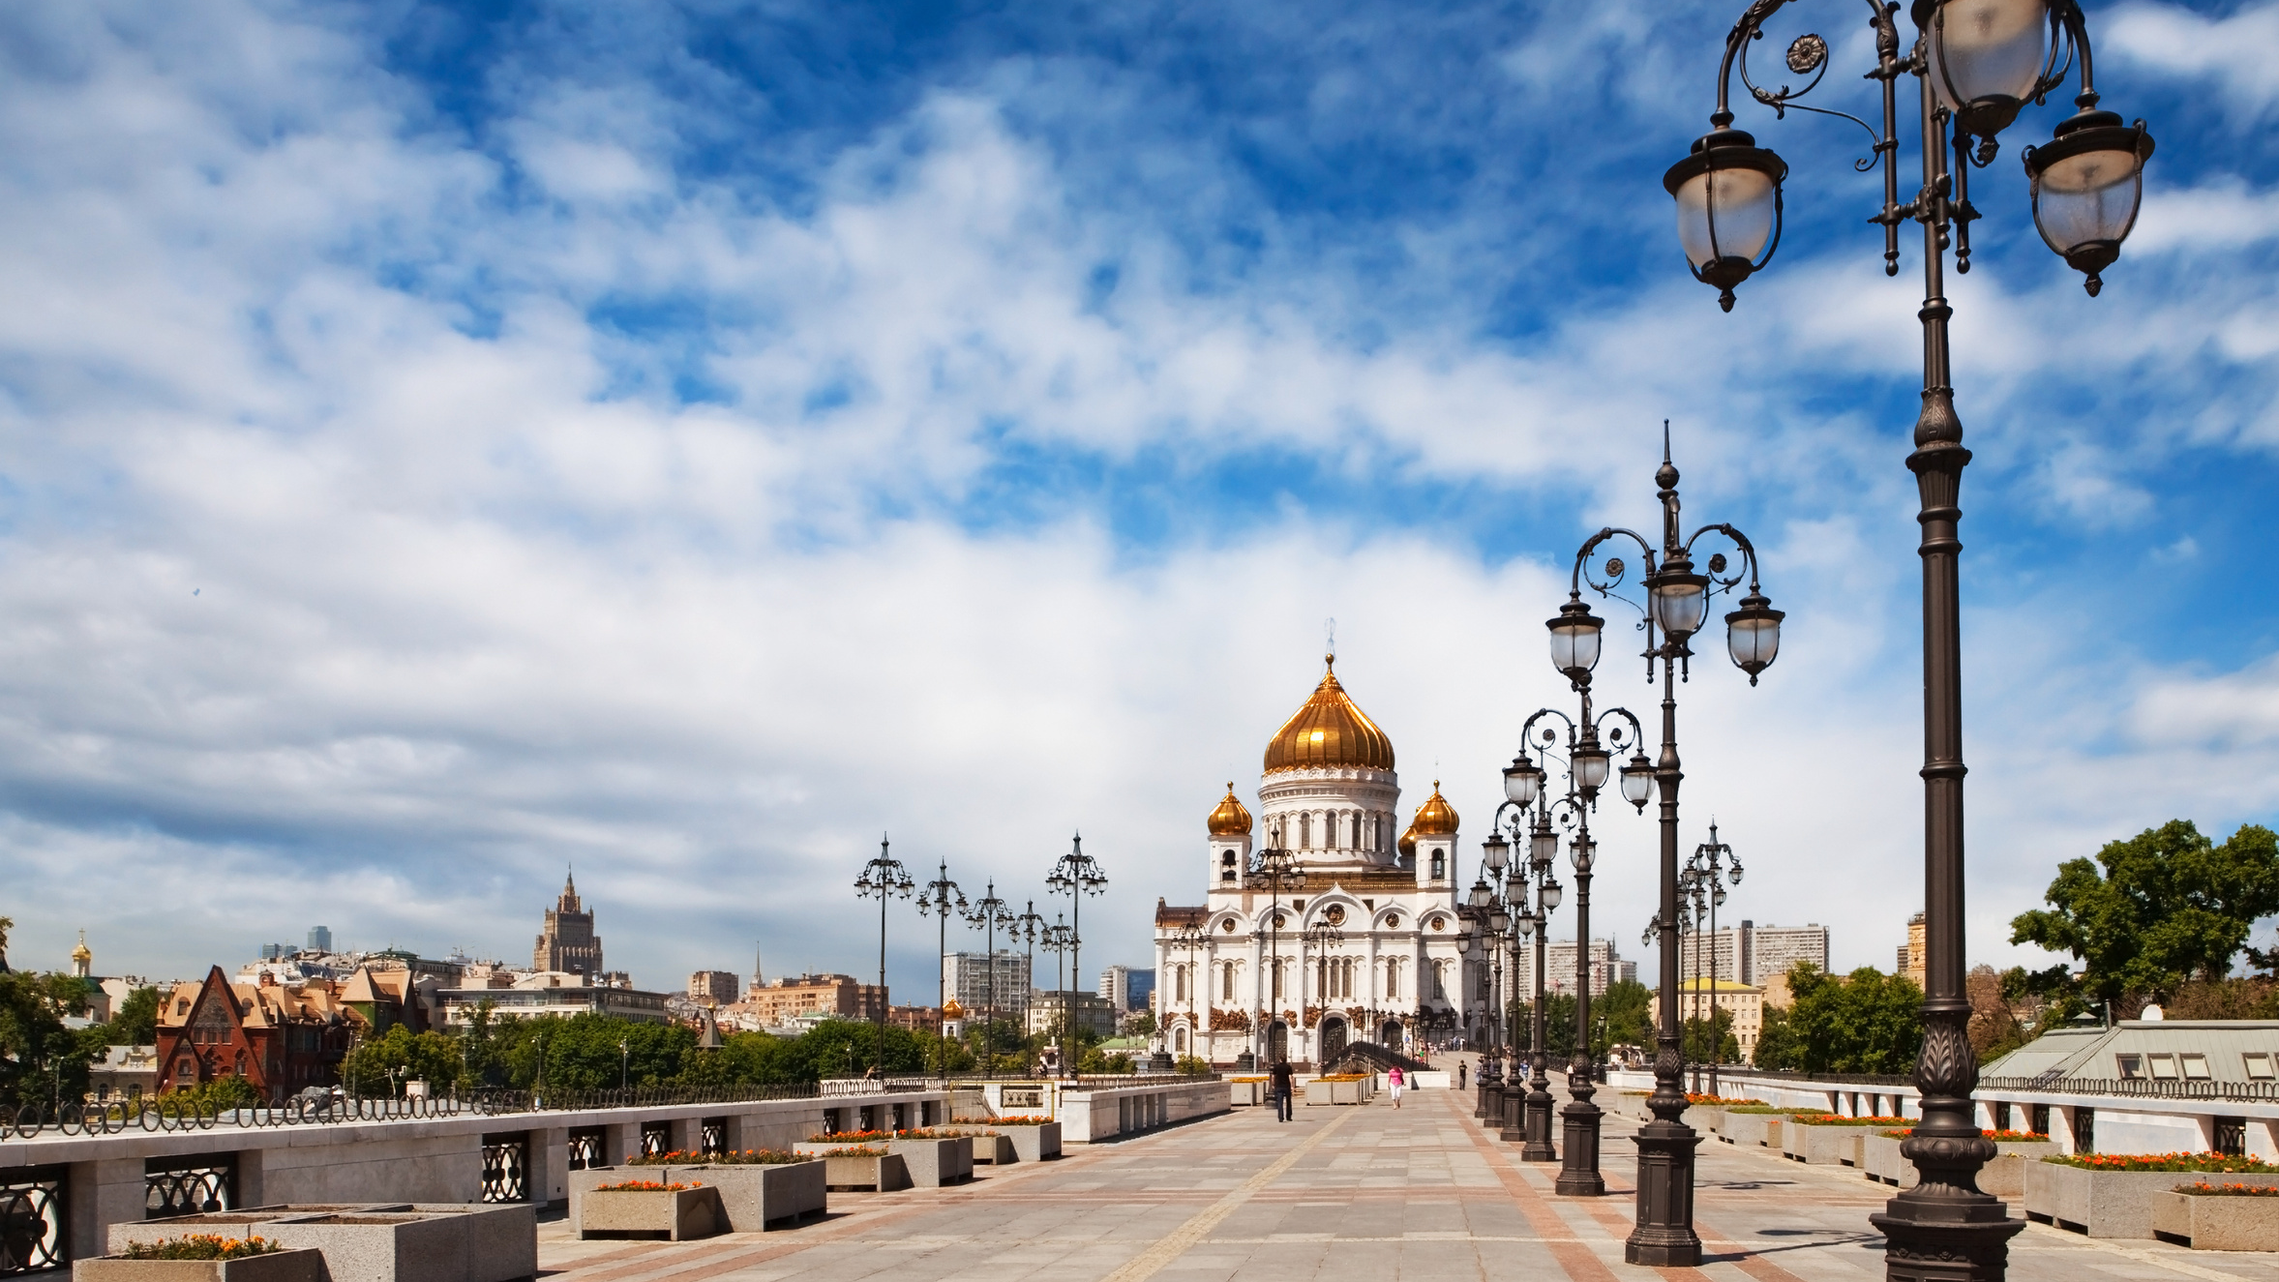

Slide 15
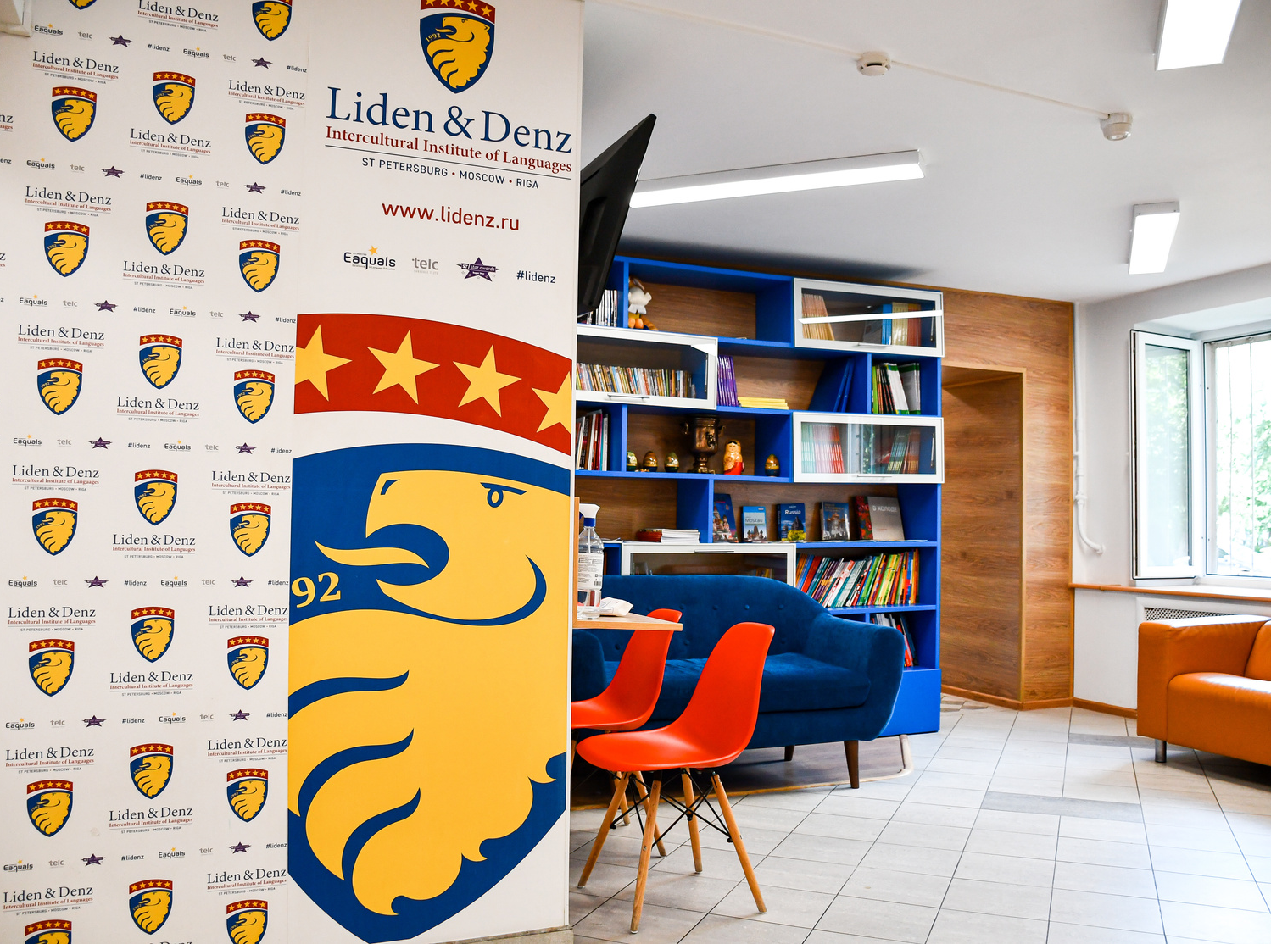
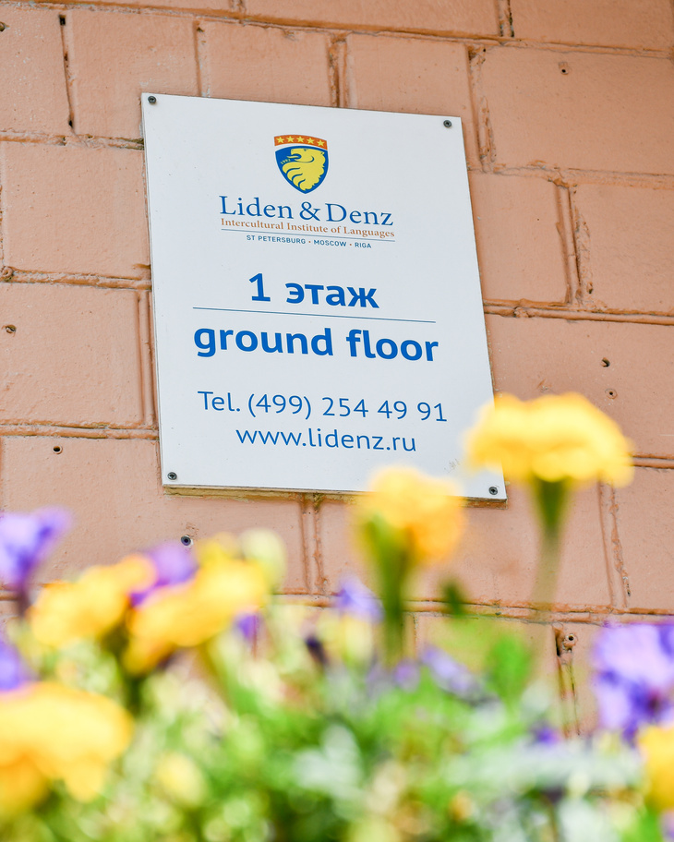
Liden & Denz Moscow
Less than 5 minutes walk from the Belorusskaya Metro Station
6 classrooms
Wall-mounted LCD screens in all classrooms
Free coffee & tea
Free WiFi

Slide 16
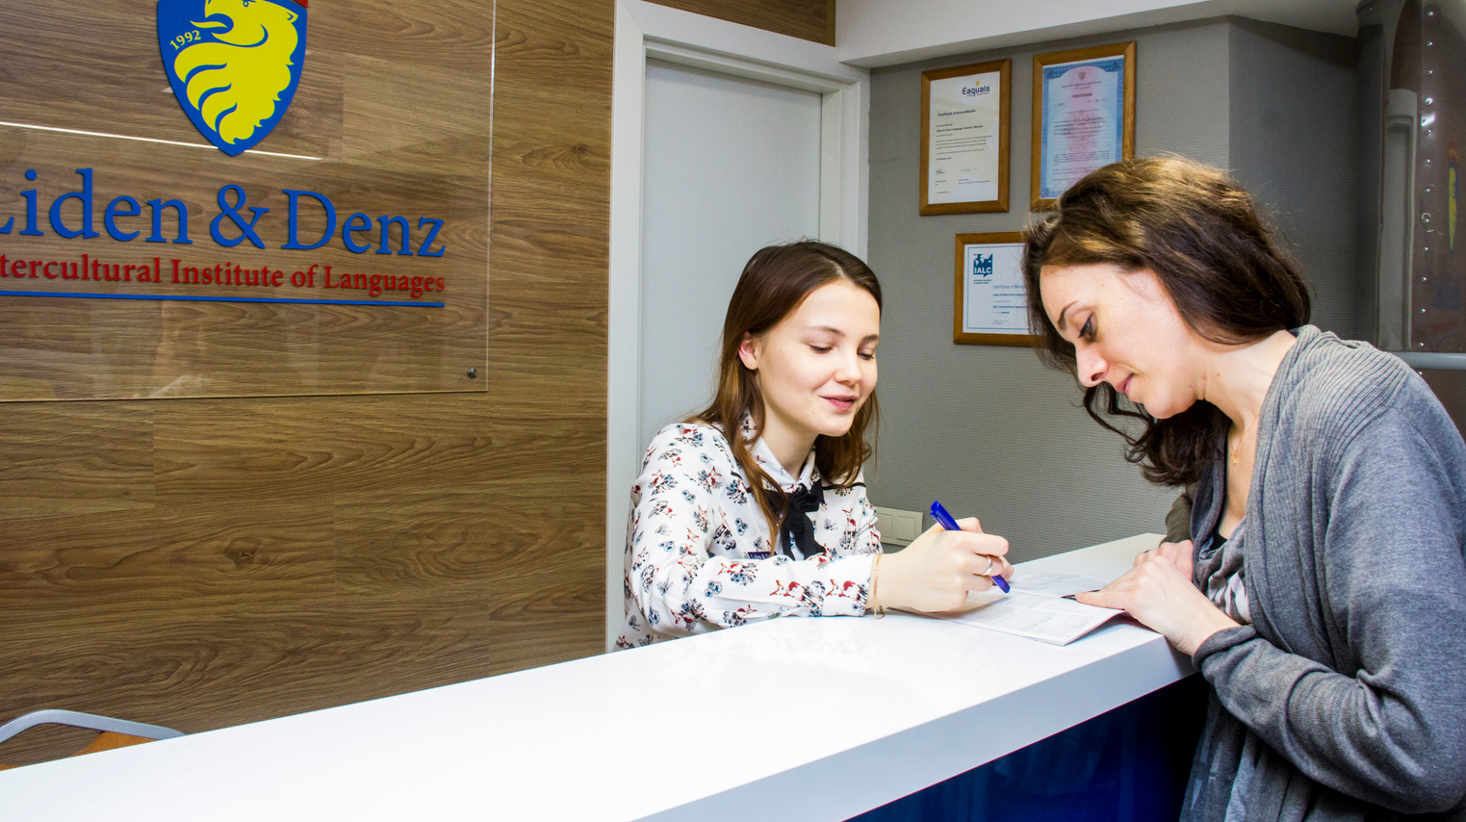
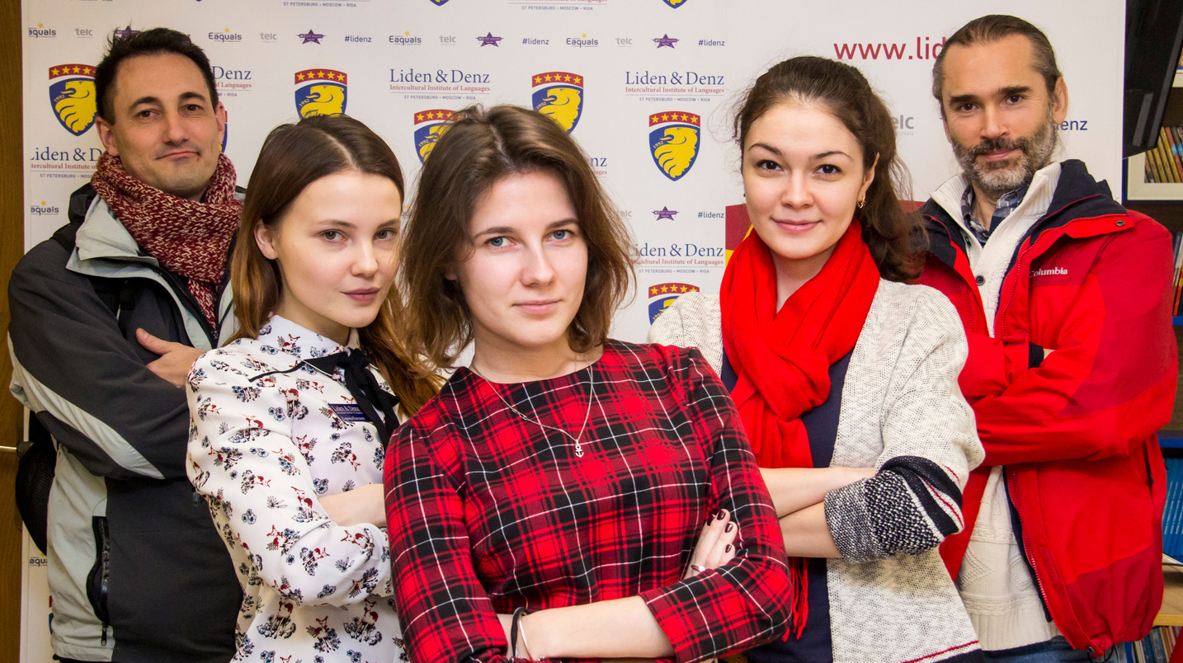
Group Courses: Maximum group size - 12

Slide 17
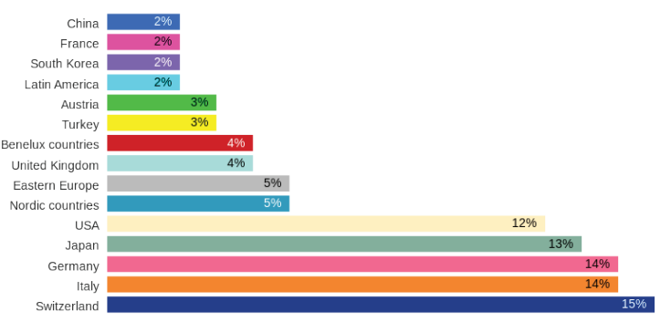
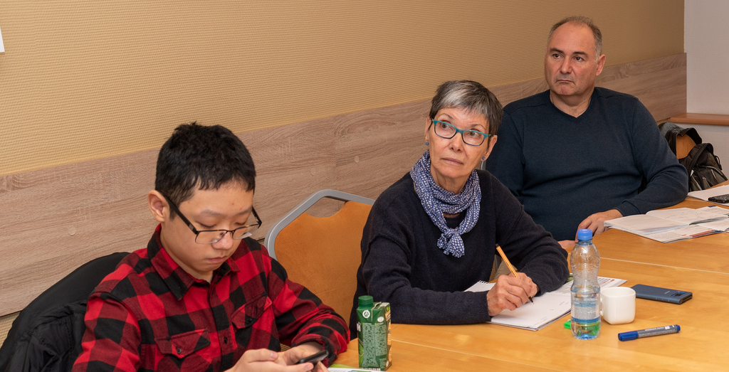
Liden & Denz Moscow
Student Mix by country or region
Student Mix by age

Slide 19
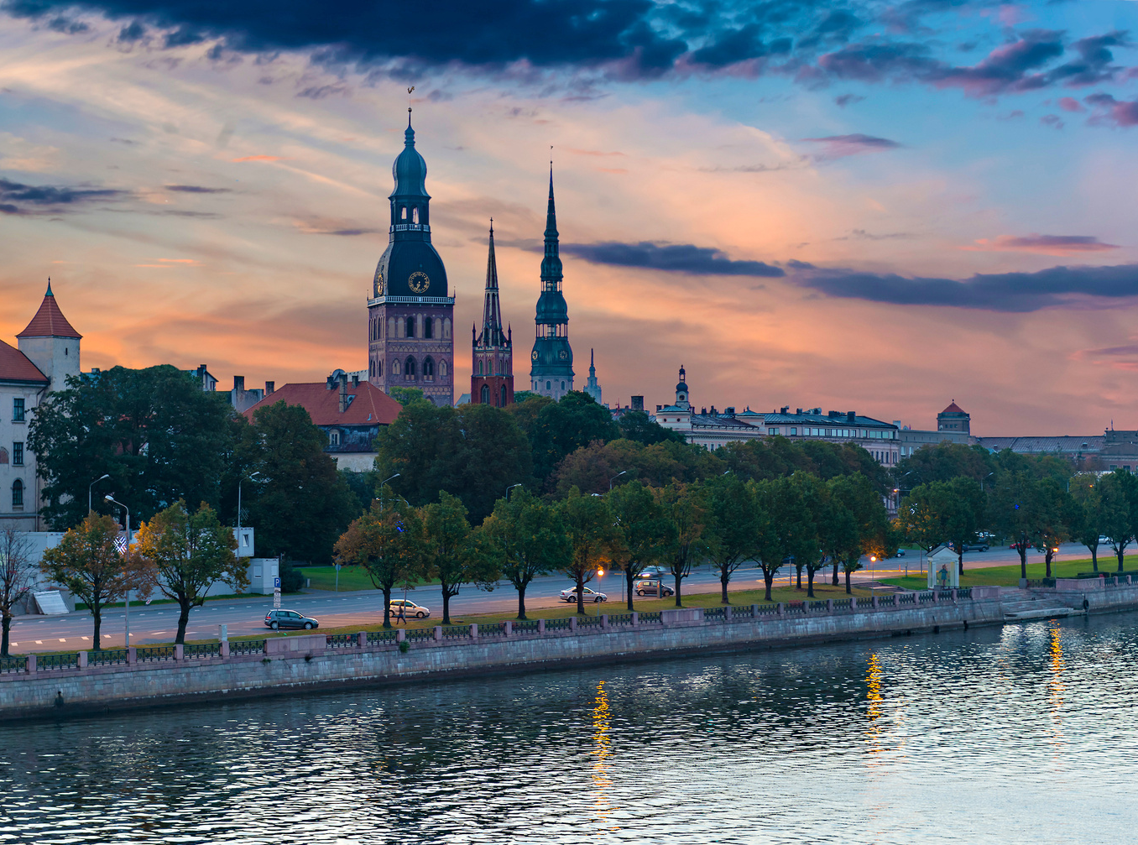
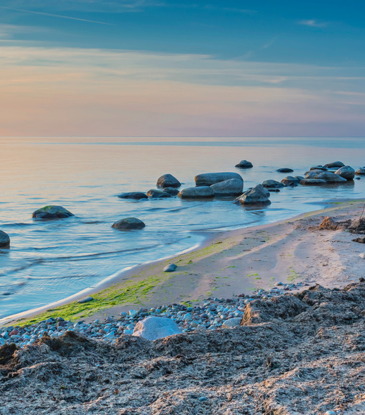
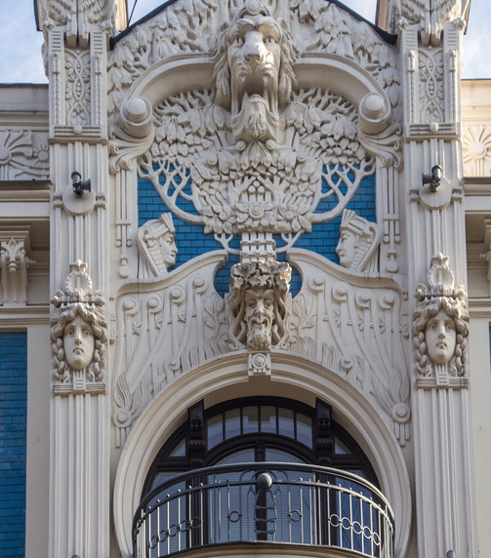
Riga
Riga is the capital of Latvia and the largest city of the Baltic republics.
Latvia gained independence from the Soviet Union in 1991. In 2004 the country joined the European Union.
Riga is the only city outside Russia, Ukraine and Belarus with a clear majority of Russian speakers.
The nearby beach resort and beautiful parkland Jurmala lets everyone enjoy nature close to the city

Slide 20
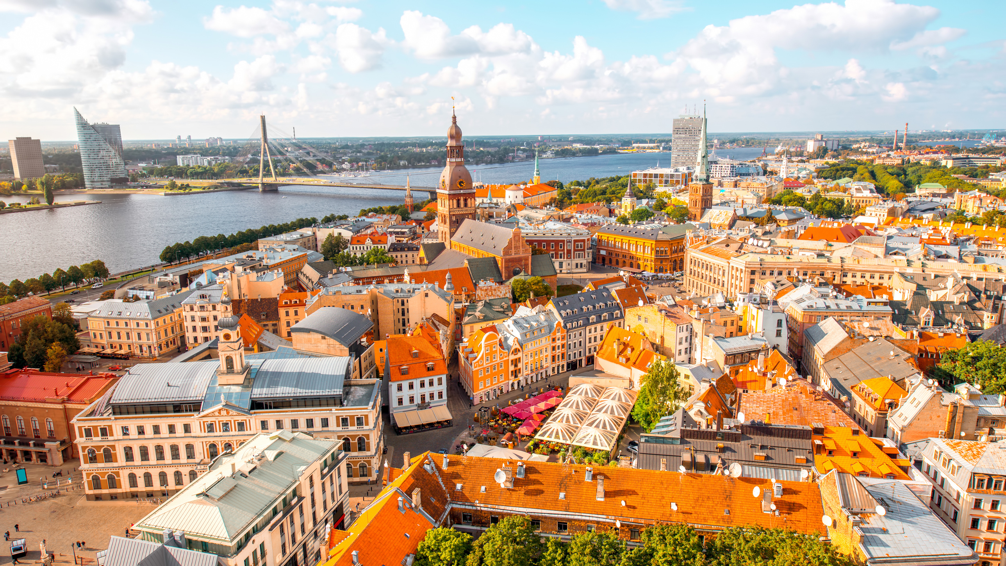

Slide 21
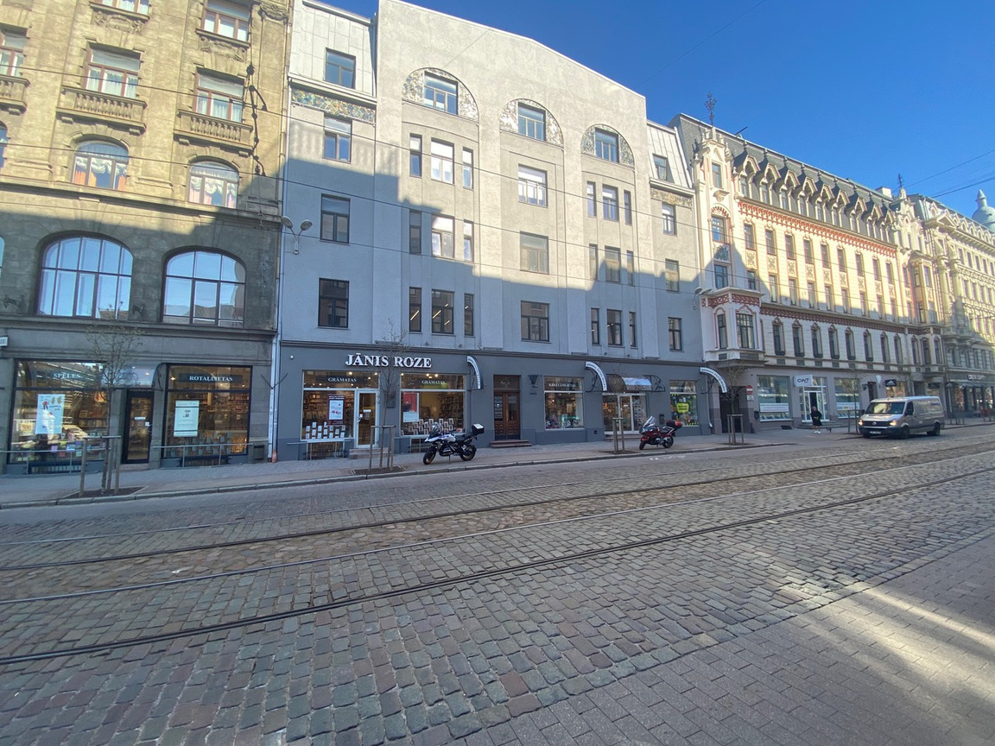
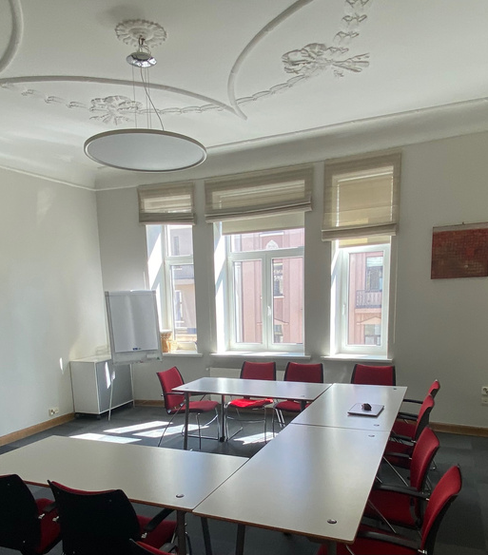
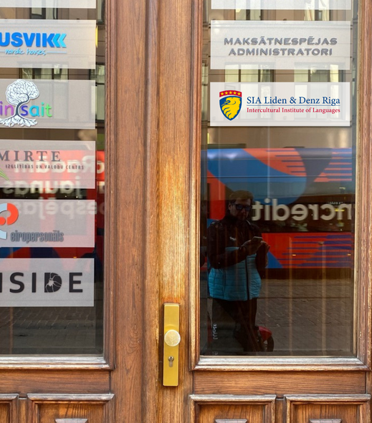
Liden & Denz Riga
The new Liden & Denz Riga campus is located in the city centre on Krišjāņa Barona Iela 5 in a recently renovated landmark Art Nouveau building less than 10 minutes walking distance to Vecrīga (Old Medieval Town).
Vermane Public Gardens are just around the corner
7 classrooms
The facilities include a small lounge area plus a kitchen.
Free WiFi

Slide 22
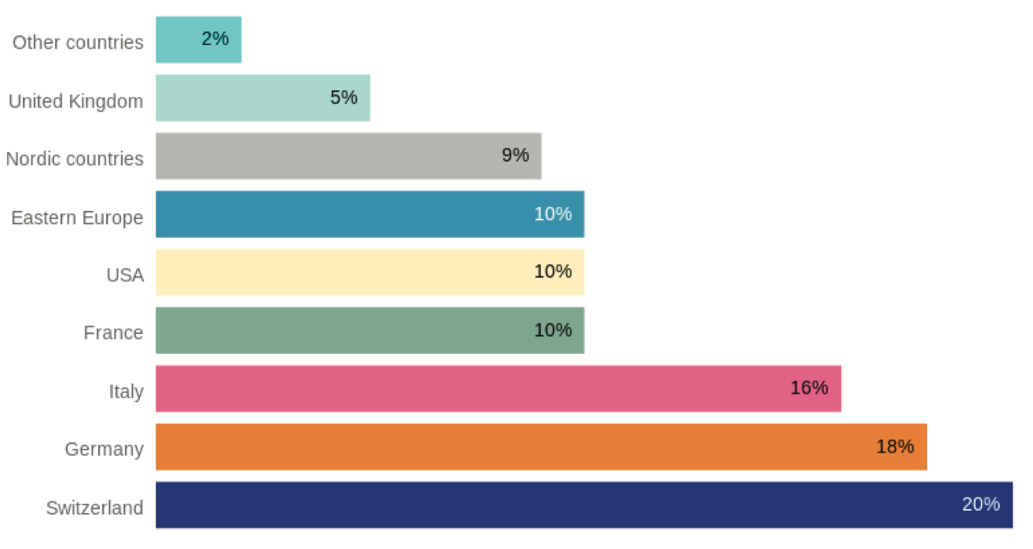
Liden & Denz Riga
Student Mix by country or region
Student Mix by age

Slide 24
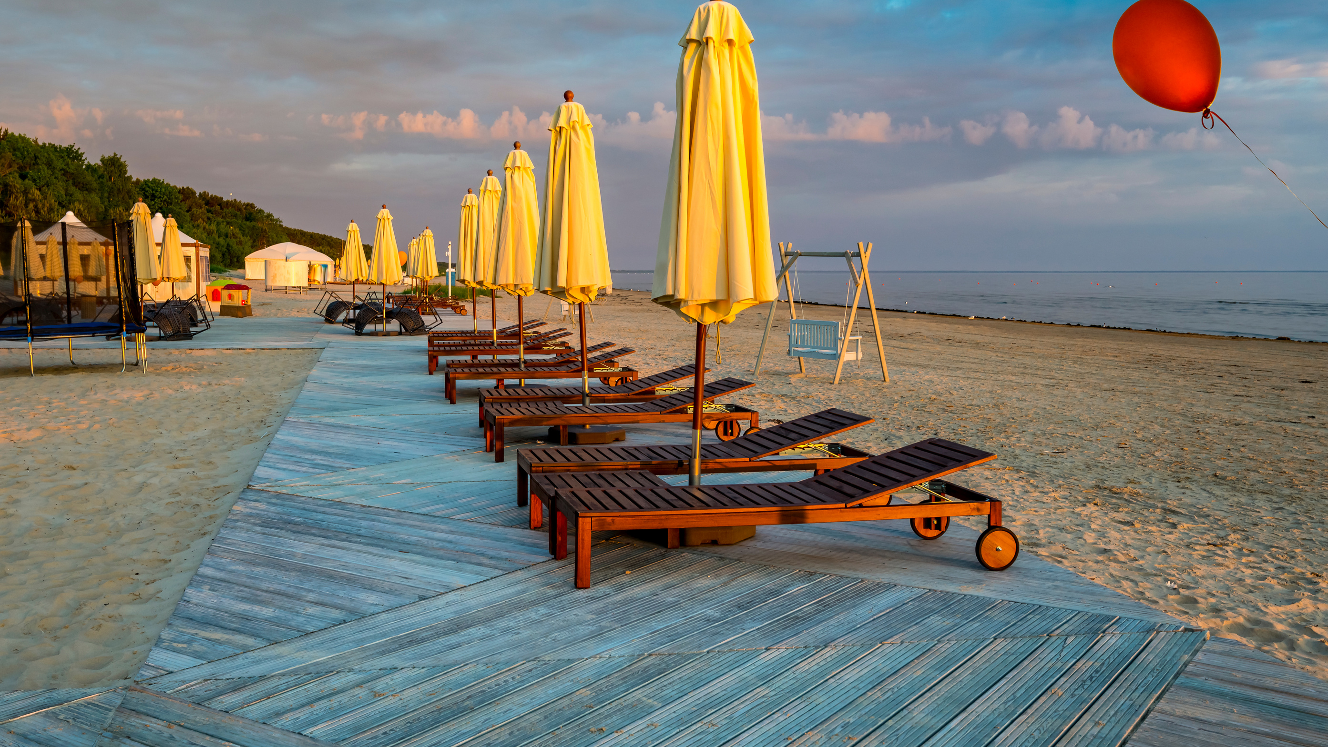

Slide 25
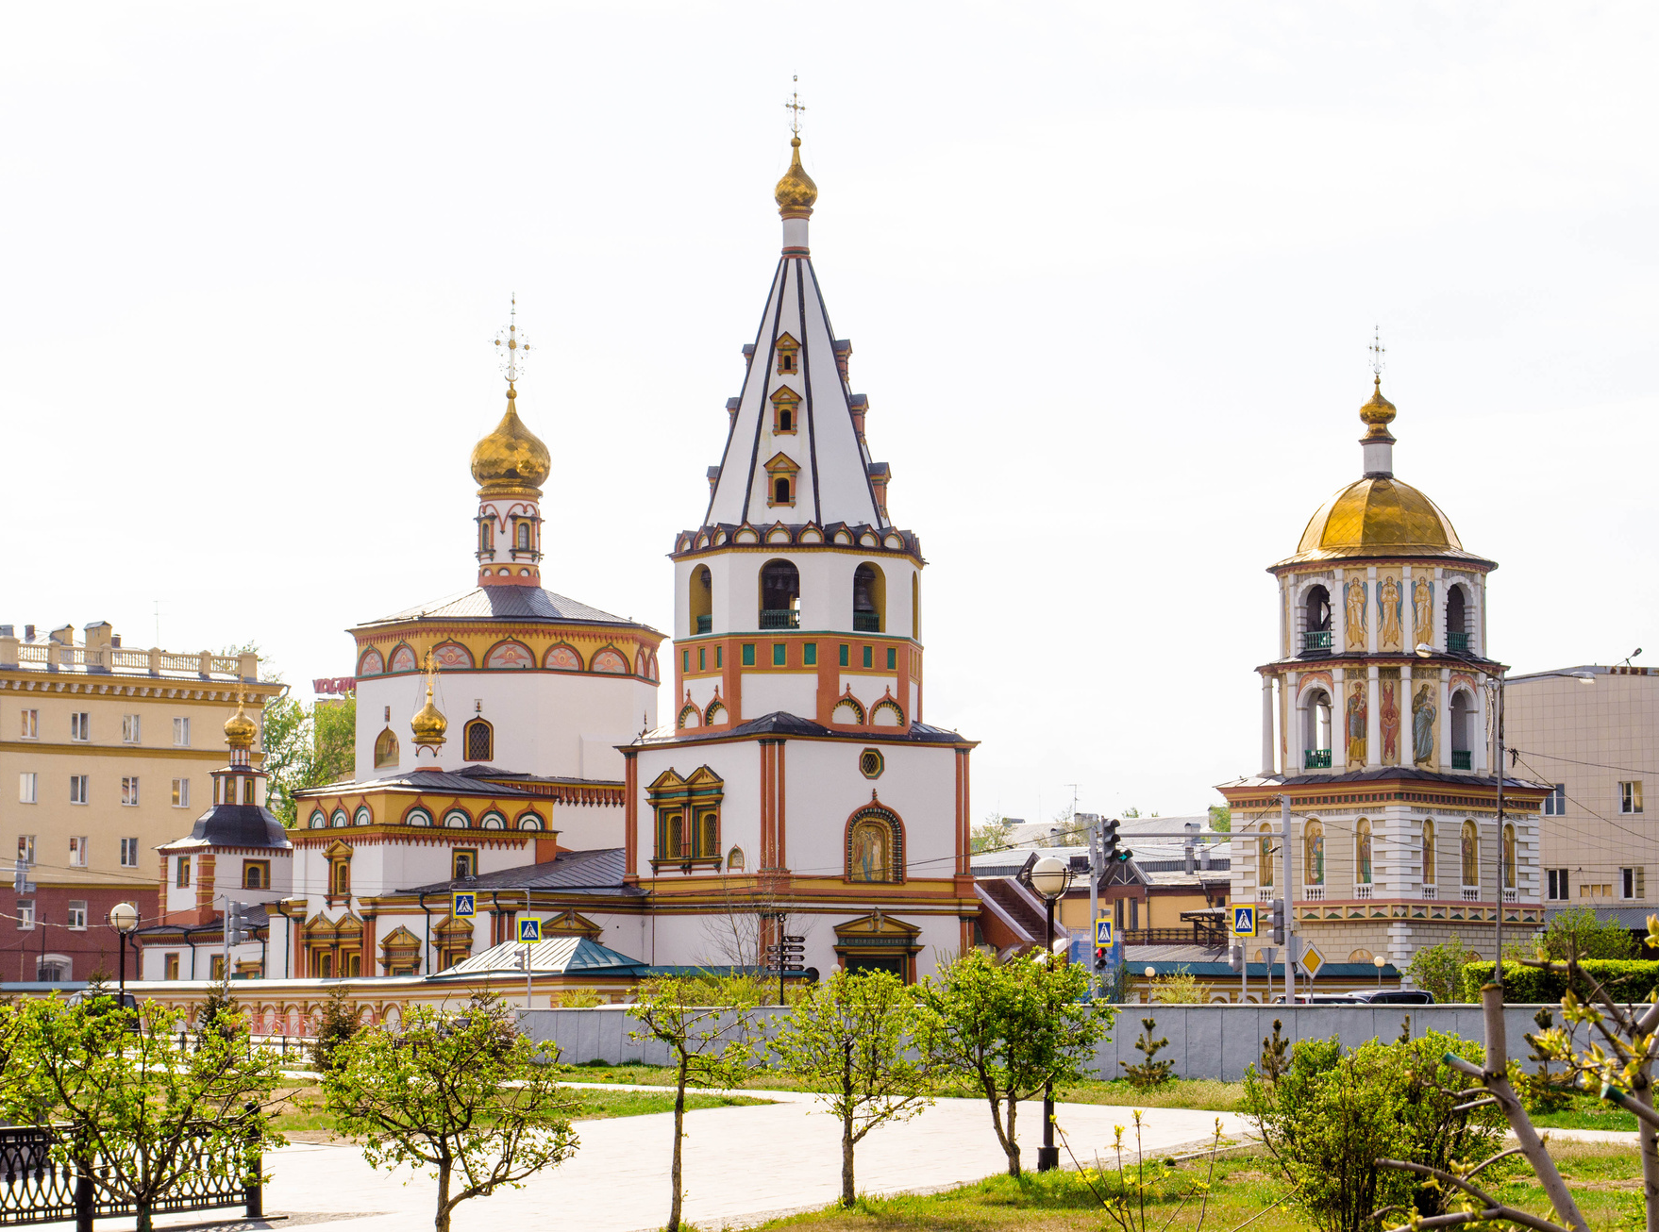
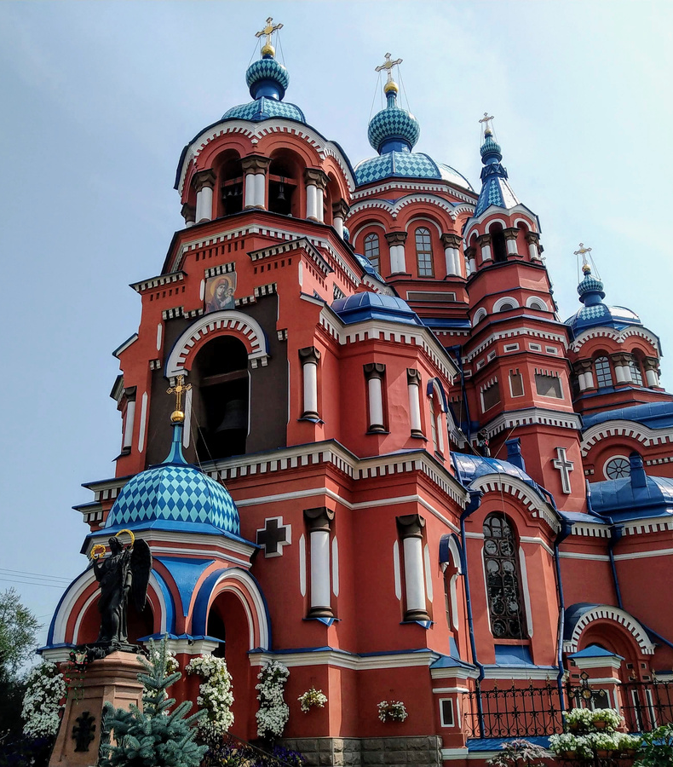
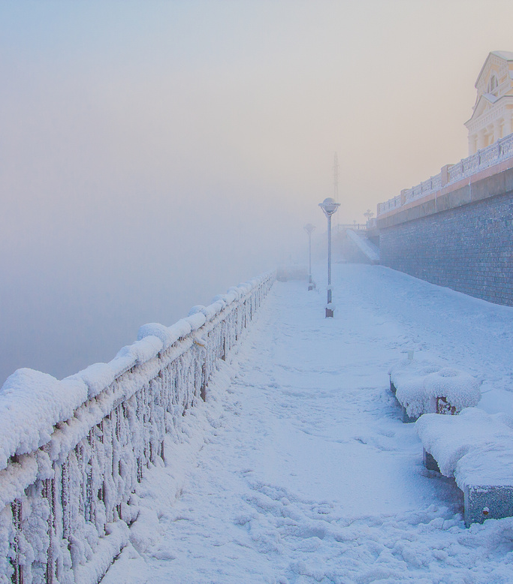
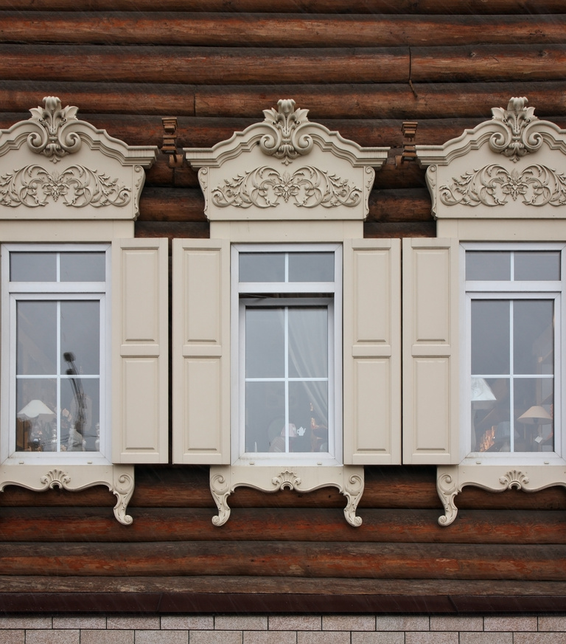
Irkutsk (Siberia)
Founded as a fortress over 350 yrs ago
A home for many exiled revolutionaries
The city is located in the centre of Eurasia, on the centuries-old crossroads of trading ways between the East and the West
now - the Trans-Siberian Railway, connecting Moscow and the Russian Far East with branch lines into Mongolia, China and North Korea.
1 hour drive from lake Baikal

Slide 26
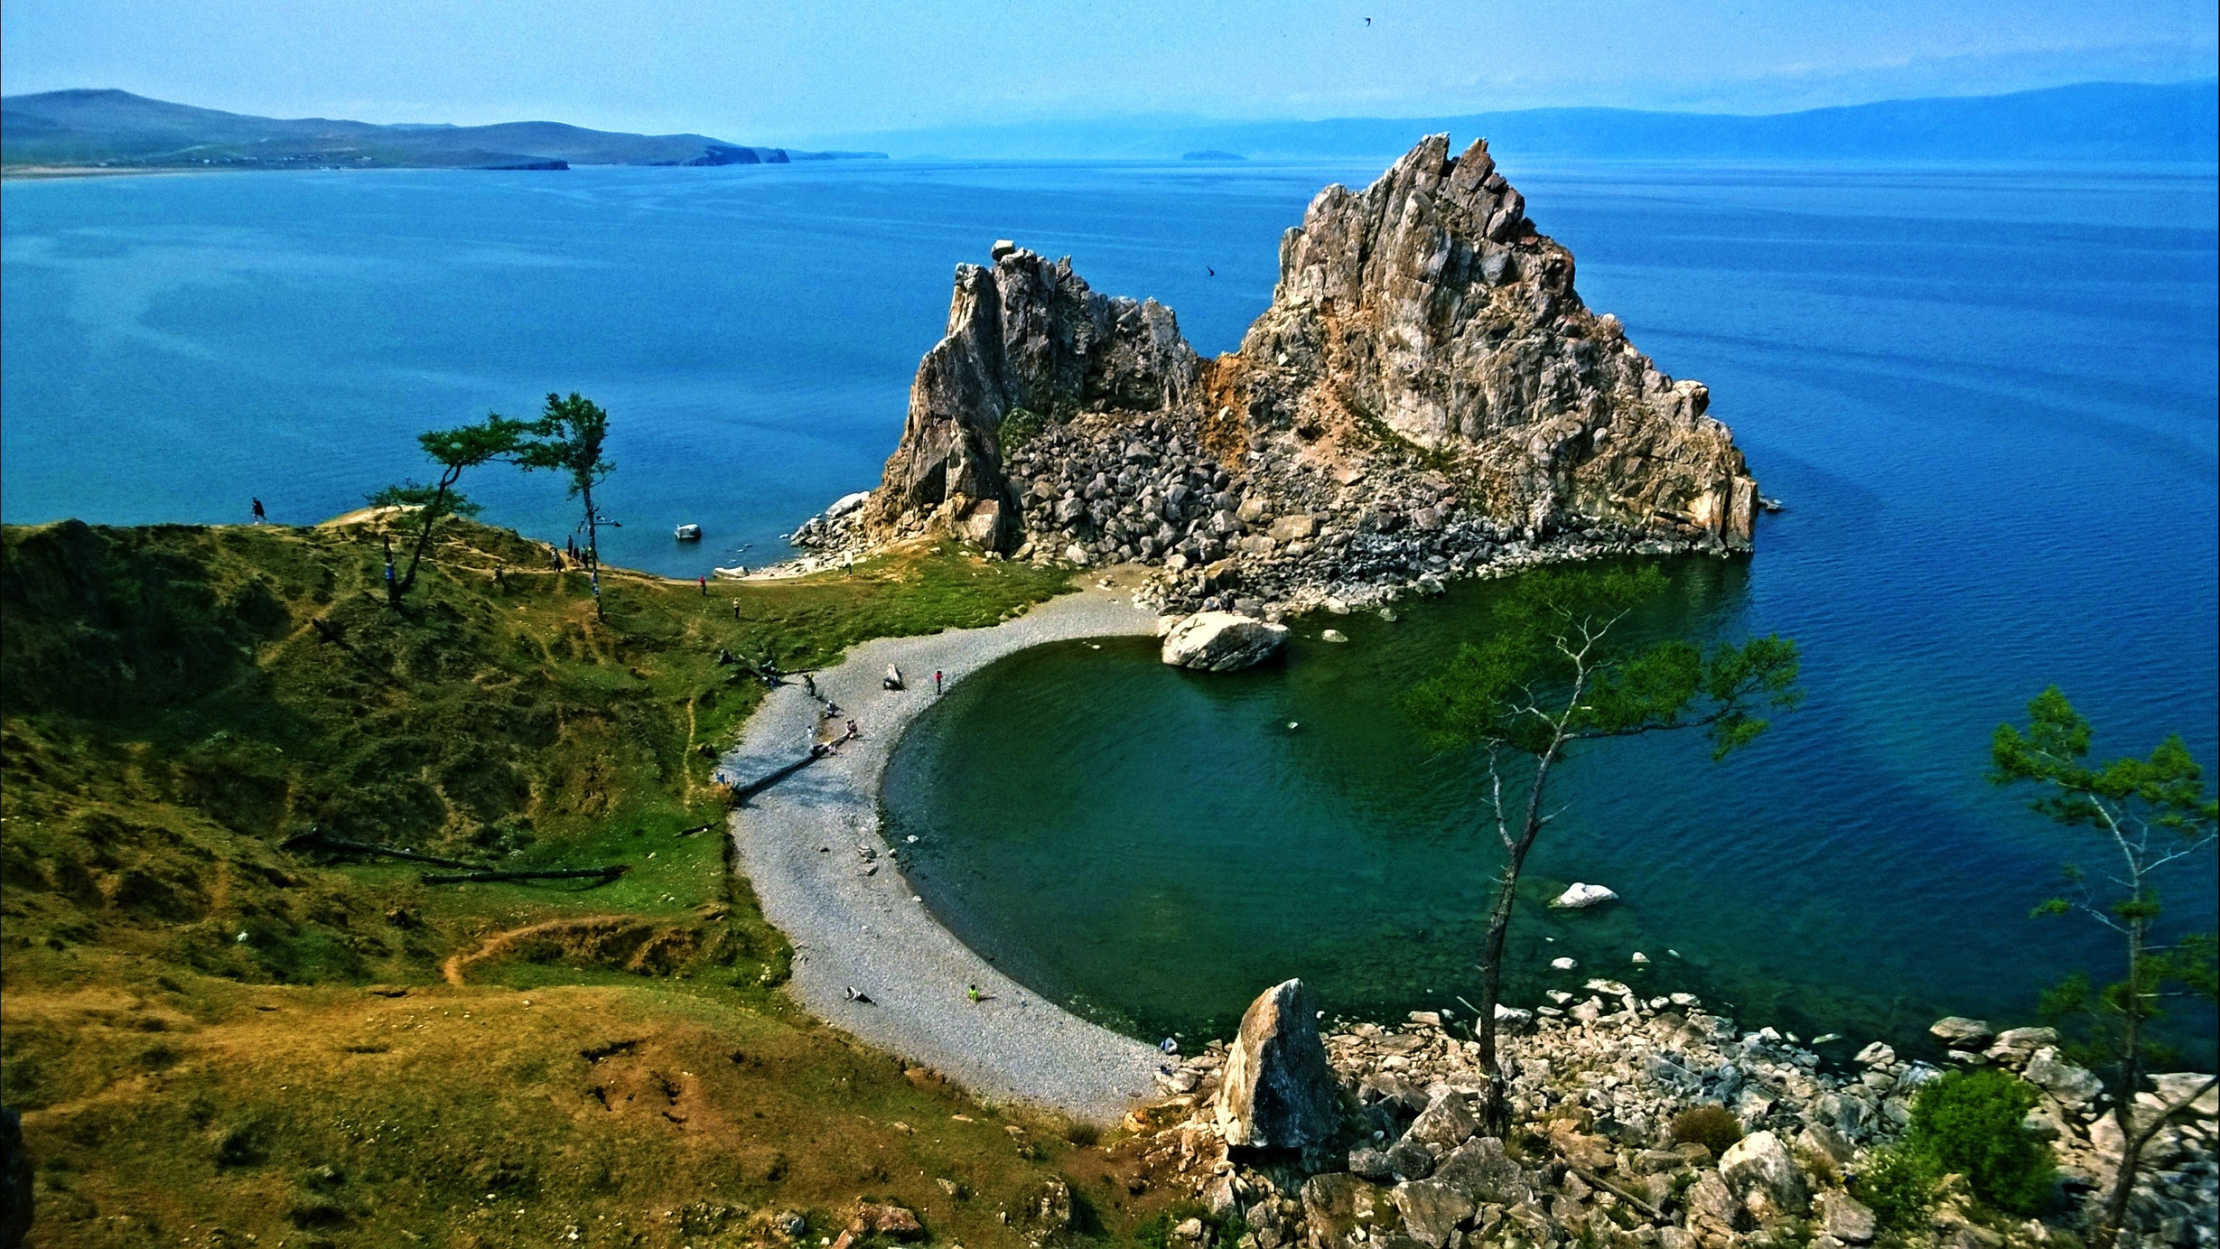

Slide 27
Lake Baikal
25-million year old reservoir of fresh water
The world’s deepest, cleanest and oldest lake; 20% of the planet’s fresh water supply
Size of Belgium
A mile deep
Framed by breathtaking landscapes.

Slide 30
Liden & Denz Irkutsk
Opened in June 2017
6 classrooms
Self-study centre and student lounge
Free WiFi
Cultural sights and eco-tourism
Student Mix by country or region

Slide 31
Group Courses: Maximum group size - 6
Available in February and March and for the whole summer season

Slide 33
Activities
Free city tour upon arrival
Social/cultural programme
Ticket reservation desk
Onward travel desk

Slide 34
Activities

Slide 35
Accommodation Options
Host-family BB & HB
Shared flats
Studio Apartments
Hotels

Slide 36
Shared Flats
&
Host Families

Slide 37
Russian Visa vs. Latvian Visa
Everybody needs one (few exceptions in Latin America and Eastern Europe)
Tourist visa up to 4 weeks (one entry - no extensions)
Student visa for Schengen citizens up to 3 months (one or double entry - no extensions)
Student visa for the rest of the world and up to one year (multiple entry)
Latvia is a Schengen country: most students will travel visa-free.
List of nationalities traveling visa-free up to 90 days within half a year, but requiring a residence permit for longer stays: USA, Canada, Australia, Japan, Korea, Brazil, Serbia, Croatia, etc.
Others (e.g. students from Turkey and even Russians) need a student visa, which can be valid up to 90 days, or a residence permit - for longer stays

Slide 38
lidenz.com

